Slide 1
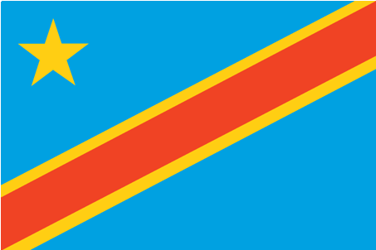
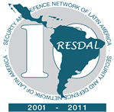
United Nations Organization Mission in the Democratic Republic of the Congo
Mission de l’Organisation des Nations Unies en République Démocratique du Congo
PROMOTING GENDER TO BUILD PEACE
PANEL : DRC
Ms ELSIE EFFANGE-MBELLA
Senior Gender Advisor, MONUSCO
Ms MARIE ONIWA
Head Sexual Violence Unit , MONUSCO
Colonel Devendra Sharma
Chief Military Personnel Officer MONUSCO
Ms MARIE-JACQUELINE RUMBU
Director General, Ministry of Gender, GoDRC

Slide 2
ISSUES TO BE ADDRESSED
SPECIFIC CONTEXT MUNUSCO FACES IN CURRENT DEPLOYMENTS
MANDATE AND ROLE OF MONUSCO
GENDER MANDATE AND EVOLUTION
SEXUAL VIOLENCE – UNSCR/COMPREHENSIVE STRATEGY
INTERFACE BETWEEN CIVILIAN, MILITARY AND POLICE IN MONUSCO FOR PROTECTION OF CIVLIANS
ROLE OF MILITARY IN SUPPORTING THE GENDER MANDATE OF THE MISSION:PROTECTION OF CIVILIANS
GENDER PERSPECTIVE AS AN OPERATIONAL NECESSITY
CASE STUDY – GENDER
PERCEPTION OF GoDRC ON GENDER ISSUES
THE WAY FORWARD…!

Slide 3
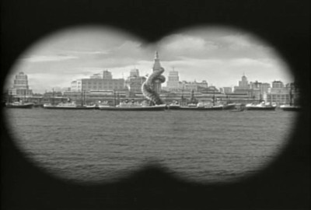
DRC OVERVIEW
Notes:
3

Slide 4
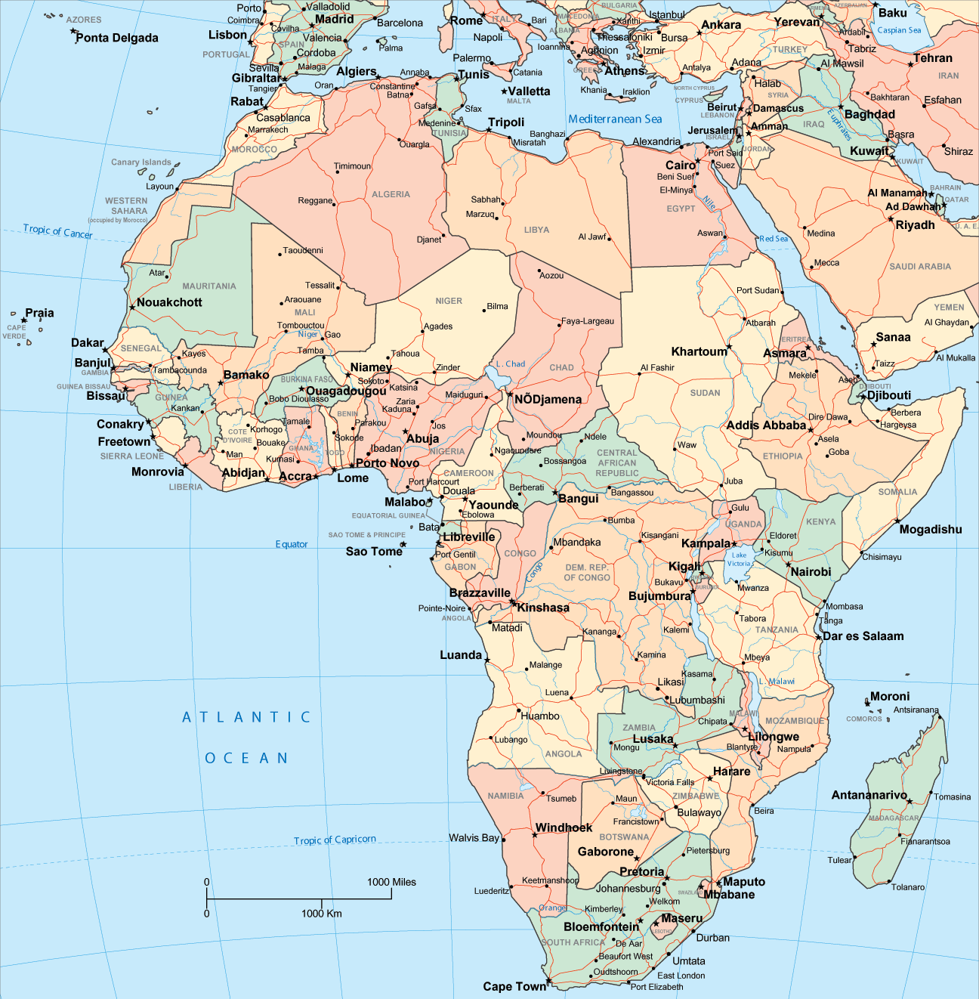
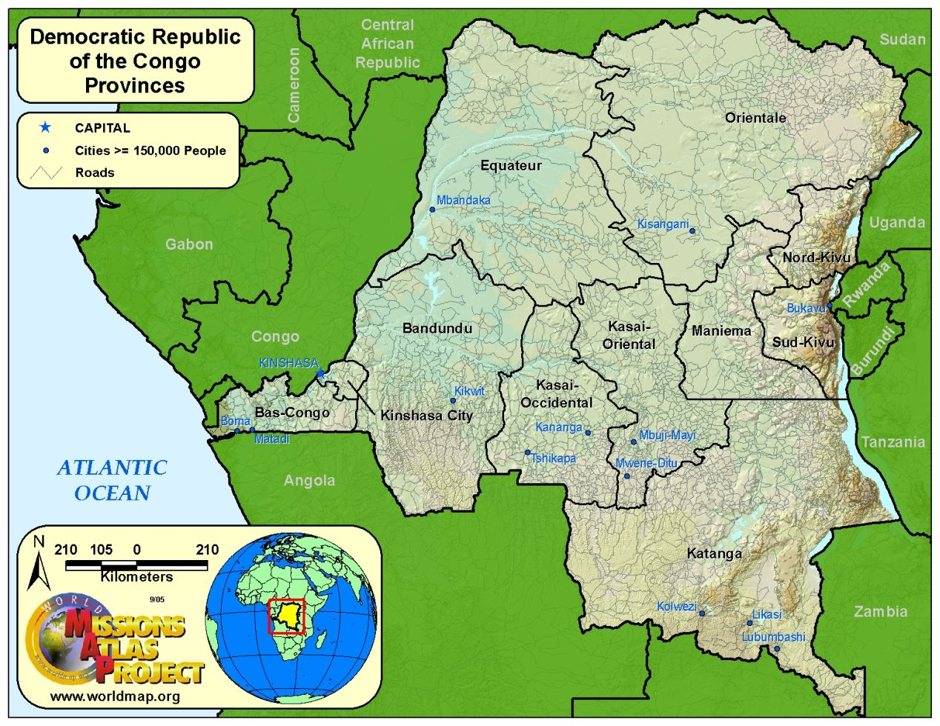

Slide 5
DRC : NEIGHBOURS
CENTRAL AFRICAN REPUBLIC
SUDAN
NINE NEIGHBOURS
UGANDA
REPUBLIC OF CONGO
DEMOCRATIC REPUBLIC OF CONGO
RWANDA
GOMA
BURUNDI
KINSHASA
TANZANIA
ANGOLA
ZAMBIA

Slide 6
OVERVIEW OF DRC
OFFICIAL LANGUAGE – FRENCH
MOTTO – JUSTICE - PEACE - WORK
GOVERNMENT – SEMI - PRESIDENTIAL
NATIONAL DAY – 30 JUN
POPULATION – 70.9 MILLION
OLD BELGIAN COLONY
GDP – USD $ 31 BILLION
CURRENCY – CONGOLESE FRANC
TIME ZONE - +1 TO +2 HRS GMT
SIZE - 1,900 x 1,900 KM
3rd LARGEST IN AFRICA
12TH LARGEST IN WORLD
HUMAN DEVELOPMENT INDEX - 187TH
Notes:
6

Slide 7
OVERVIEW OF DRC
ENDOWED WITH 50 % OF ALL THE TROPICAL HARDWOODS IN AFRICA
ONE OF THE WORLD’S MIGHTIEST RIVER SYS. THE CONGO RIVER SYS HAS 10-12% OF THE WORLD’S POTENTIAL HYDROELECTRIC CAPACITY
HAVING MANY OF THE WORLD’S ENDANGERED ANIMAL SPECIES – BONOBO GORILLAS
HOME TO THE 2ND LARGEST RAINFOREST IN THE WORLD – 80 % COVERED BY JUNGLE
Notes:
7

Slide 8
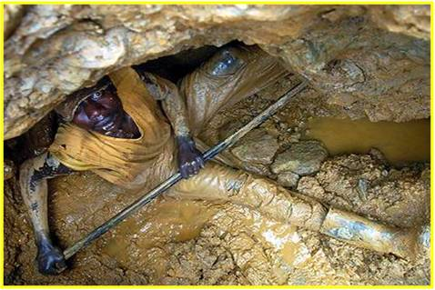
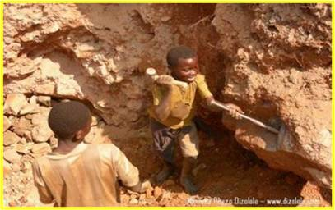
OVERVIEW OF DRC
NATURAL WEALTH
AMONG THE TOP 10 COUNTRIES IN TERMS OF RES OF GOLD, INDUSTRIAL DIAMONDS, COPPER, COBALT , CASSETERITE & COLTAN
34% OF TOTAL COLTAN RES PRESENT ON EARTH
10% OF TOTAL COPPER RES PRESENT ON EARTH
Notes:
8

Slide 9
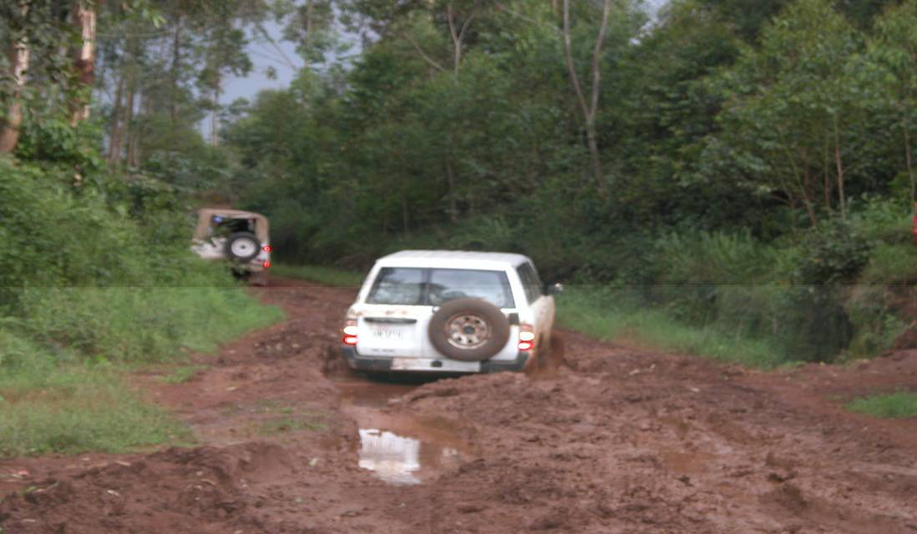
COMN INFRASTRUCTURE
INFRASTRUCTURE:
Railways: 5,138 km
Roads: 145,000 km
Paved : 2,500 km
Unpaved: 142,500 km
Waterways: 15,000 Km
Ports/ Harbors: 10
Airports/Airfields: 235
Paved: 25
Unpaved: 210
Pipelines (2006) :
Gas: 54 km
Oil: 78 km

Slide 10
AIRSTRIPS
WALIKALE- KILAMBO
BENI
MAVIVI
GOMA

Slide 11
DRC POL DIV
11 PROVINCES
ADMINISTRTIVE REGIONS

Slide 12
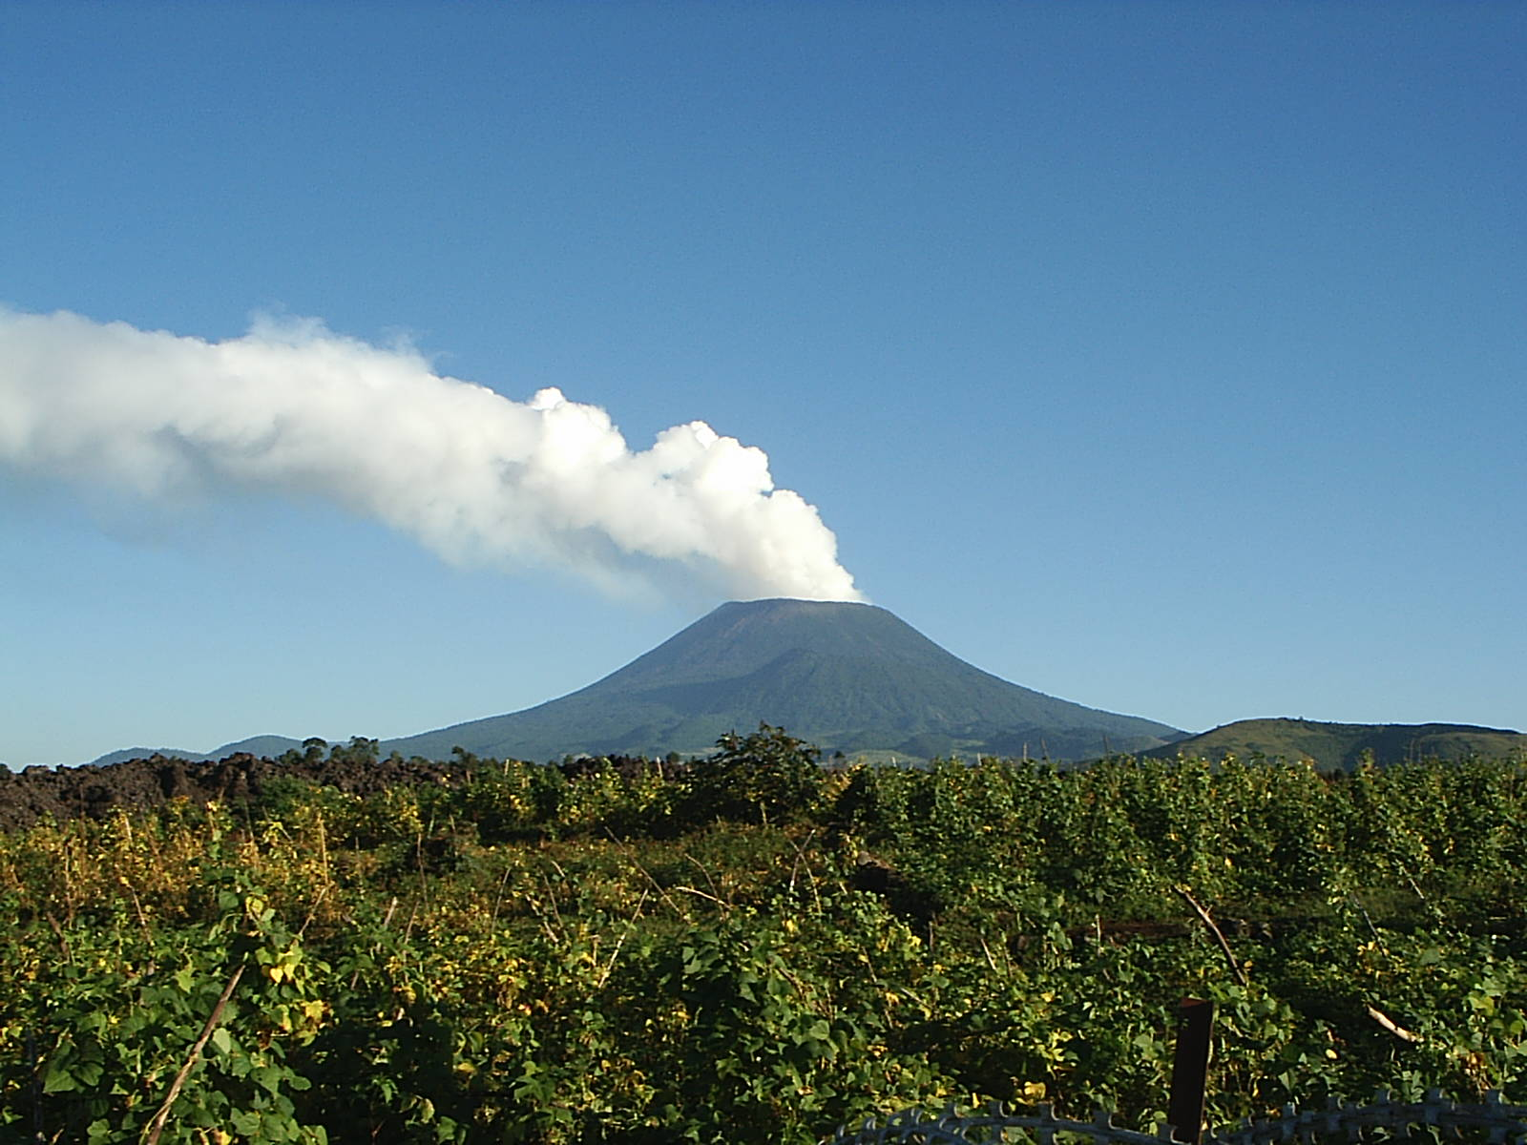
LAST ERUPTED - 2002
ONE OF EIGHT ACTIVE VOLCANOES IN DRC
PRESENT SEISMIC ACTIVITY ON THE DECLINE
NYIRAGONGO

Slide 13
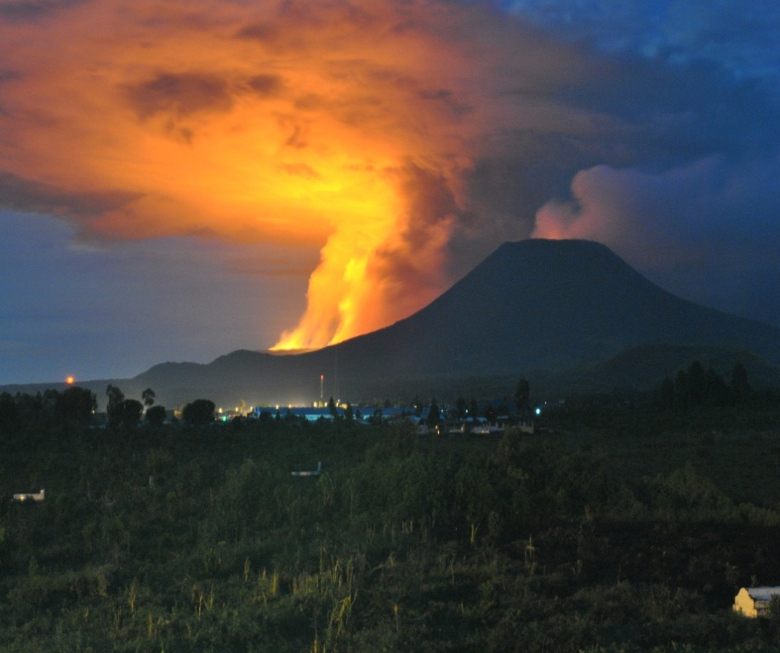
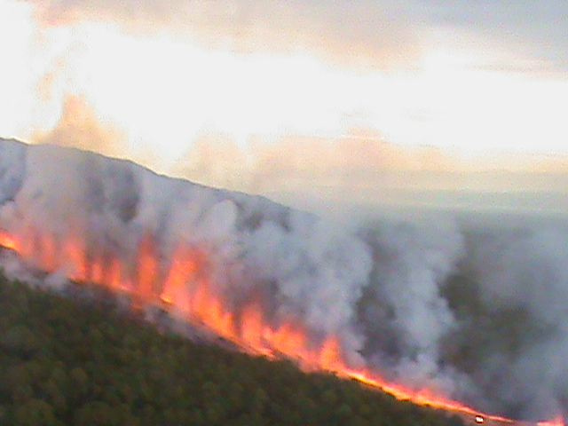
NYAMULGIRA – 02 JAN 10
ERUPTIONS FROM 2 FISSURES ON THE SIDE - NIGHT 6/7 NOV 2011 & NIGHT 8/9 DEC 2011.
SHIELD TYPE VOLCANO.
FIRST RECORDED ERUPTION IN 1865.
KNOWN TO ERUPT ROUGHLY EVERY TWO YEARS.
LAST ERUPTION IN 2006.
ONE OF AFRICA’S MOST ACTIVE
VOLCANO

Slide 14
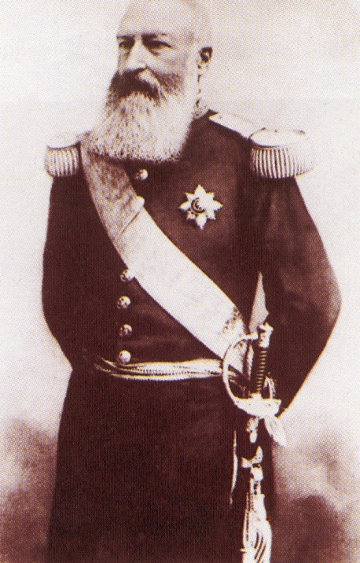
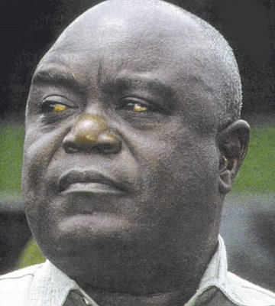
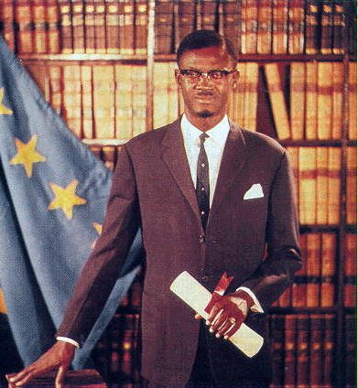
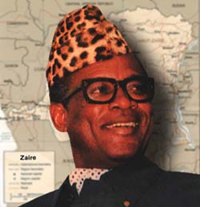
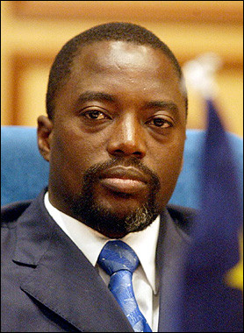
HISTORICAL PERSPECTIVE

Slide 15
THE AFRICAN CONGO FREE STATE
1877-1908
THE POPULATION OF CONGO WAS REDUCED TO HALF DUE TO SLEEPING SICKNESS AND SMALL POX
1904 – INTERNATIONAL PROTESTS LODGED BY ED MOEL AND BRITISH DIPLOMAT ROGER CASEMENT CONDEMMED THE PRACTICE
BRUTALISED LOCAL POPULATION TO PRODUCE RUBBER
HE MADE THIS LAND HIS PRIVATE TERRITORY AND NAMED IT CONGO FREE STATE
1885 CONFERENCE OF BERLIN – KING LEOPOLD II AQUIRED RIGHTS TO CONGO TERRITORY
Notes:
15

Slide 16
BELGIAN CONGO : 1908-1960
INTERNATIONAL PRESSURE WAS EXERTED ON BELGIUM ESPECIALLY FROM UK
PRESSURE WAS TO COMPEL BELGIUM TO TAKE OVER THE COLONY FROM KING LEOPOLD 2
IN 1908, CONGO WAS TAKEN OVER FROM KING LEOPOLD 2 AND WAS RENAMED BELGIAN CONGO
Notes:
16

Slide 17
POLITICAL CRISIS : 1960-65
SEP 1960 – POLITICAL CRISIS
KASAVUBU DISMISSES LUMUMBA
30 JUN 1960 – ACHIEVED INDEPENDENCE AND RENAMED ‘REPUBLIC OF CONGO’
PARLIAMENT ELECTED JOSEPH KASAVUBU AS PRESIDENT
1960 PARLIAMENTARY ELECTIONS WON BY MOVEMENT OF NATIONAL CONGOLIAS (MNC) LED BY PATRICE LUMUMBA
LUMUMBA WITH SUPPORT OF JOSEPH MOBUTU – CHIEF CONGO ARMY NEUTRALISES KASAVUBU
1965 – MOBUTU OVERTHREW KASAVUBU IN A COUP. RENAMED DRC
1961 - LUMUMBA ASSASINATED
Notes:
17

Slide 18
ZAIRE : 1971-97
MOBUTU RECEIVED WESTERN SP AND IN TURN HE PERMITTED NATURAL RESOURCES TO BE EXPORTED FROM ZAIRE
ONE PARTY SYSTEM - PERIODIC ELECTIONS HELD WITH MOBUTU AS ONLY CANDIDATE
PRESIDENT JOSEPH MOBUTU SESE SEKO RULES ZAIRE AS HEAD OF STATE
1971- RENAMED ‘ REPUBLIC OF ZAIRE
WESTERN SUPPORT WEANED WITH DISSOLUTION OF USSR IN 1980s
POL OPPONENTS STEPPED UP DEMAND FOR REFORM . 1997 – CONFLICT FORCED MOBUTU TO FLEE
MOBUTU’S GOVERNMENT WAS GUILTY OF SEVERE HRV, REPRESSION & CORRUPTION – ‘ZAIRE SICKNESS’
Notes:
18

Slide 19
RWANDAN GENOCIDE
UGANDA AND RWANDA INVADE ZAIRE UNDER THE COVER OF SMALL TUTSI MILITIAS TO FIGHT HUTU MILITIA AND OVERTHROW GOVT OF MOBUTU- CONTROL OVER NATURAL RESOURCES
RWANDAN HUTUS LAUNCH CAMPAIGN AGAINST CONGOLESE TUTSIS IN EAST
RWANDAN HUTU MILITIAS OVERTHROWN BY THE TUTSI LED GOVT IN RWANDA FLEE TO EASTERN ZAIRE
THIS LED MOBUTU TO FLEE THE COUNTRY IN MAY 1997
LAURENT KABILA MARCHED TO KINSHASA NAMING HIMSELF AS THE PRESIDENT
POL OPPONENTS STEPPED UP DEMAND FOR REFORM . 1997 – CONFLICT FORCED MOBUTU TO FLEE
EXPANDED COALITION OF TWO FOREIGN ARMIES WAS LED BY LAURENT KABILA
Notes:
19

Slide 20
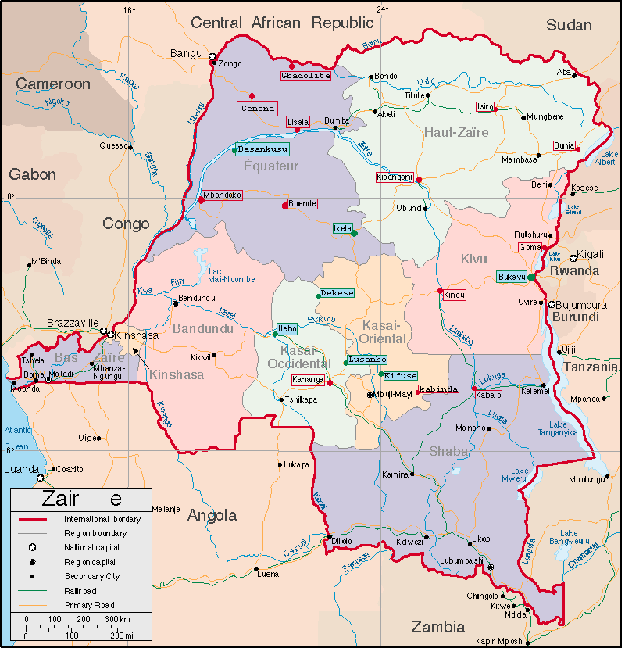
SECOND CONGO WAR : 1998-2003
BEGAN IN 1998 AND ENDED IN 2003 WHEN A TRANSITIONAL GOVERNMENT
WAS FORMED
IT INVOLVED 8 NATIONS AND 25 ARMED GROUPS
OPPOSING SIDES
RCD SUPPORTED BY RWANDA AND UGANDA
LAURENT KABILA INTIALLY SUPPORTED BY ANGOLA, NAMIBIA AND ZIMBABWE AND LATER JOINED BY CHAD, LIBYA AND SUDAN
Notes:
20

Slide 21
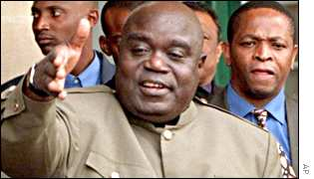
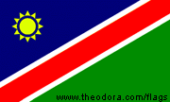
SECOND CONGO WAR : 1998-2003
AUG 98 - FEB 99
OUGANDA
MLC
MLC
RCD
JUL 1999 : LUSAKA CEASEFIRE AGREEMENT
RCD
RWANDA
RCD
BURUNDI
ANGOLA
ZIMBABWE
NAMIBIE
21
Notes:
21

Slide 22
SECOND CONGO WAR : 1998-2003
JUL 1999 : LUSAKA CEASEFIRE AGREEMENT
OUGANDA
MLC
AUG 1999 : 90 UN PEACE KEEPERS DEPLOYED
MLC
FEB 2000: 5,537 UN PEACE KEEPERS TO MONITOR CEASE FIRE
RCD
MAY-JUN 2000 : HEAVY FIGHTING COTINUES
JAN 2001 : PRESIDENT LAURENT KABILA ASSASINATED
HIS SON JOSEPH KABILA SWORN IN AS PRESIDENT
UN PULL OUT PLAN AGREED BY RWANDA & UGANDA
RCD
RWANDA
RCD
SEP 2002: LUANDA AGREEMENT – PEACE AGREEMENT BETWEEN
CONGO AND UGANDA
BURUNDI
ANGOLA
OCT 2002: 20,000 RWANDAN SOLDIERS WITHDRAW COMPLETING WITHDRAWL OF RWANDAN FORCES
ZIMBABWE
NAMIBIE
22
Notes:
22

Slide 23
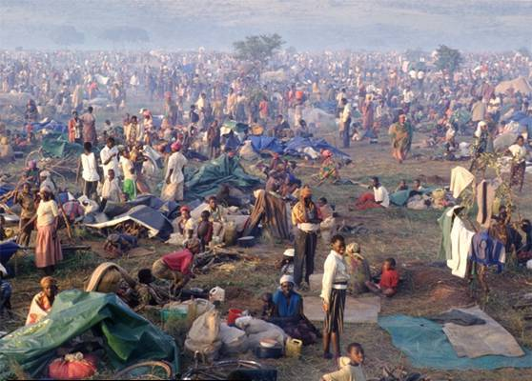
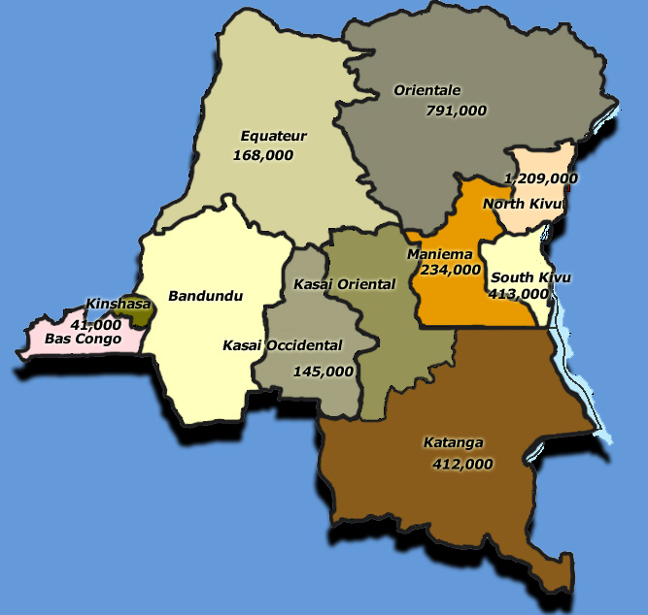
SECOND CONGO WAR : AFTERMATH
INTERNALLY DISPLACED PERSONS
CONGOLESE REFUGEES IN AFRICA
Central African Republic
Central African Republic
TOTAL 3,800,000 DIED
Congo (B)
Zambia
Sudan
Angola
Uganda
Rwanda
Burundi
Tanzania
Total 2,400,000
Total 380,000*
*number assisted by UNHCR
Notes:
23

Slide 24
WHY PROTECTION OF CIVILIANS?
2.4 MILLION IDPs & 3.8 LAKH REFUGEES
DESTRUCTION OF THE ECONOMY
COMPLETE DESTRUCTION OF INFRASTUCTURE
WAR CONTRIBUTED FOR :-
SEXUAL VIOLATIONS AGAINST WOMEN
CHILDREN ADVERSELY AFFECTED
DISEASES
-1 MILLION PEOPLE LIVING WITH HIV/ AIDS
- TROPICAL DISEASES & LACK OF INFRASTRUCTURE - EPIDEMICS
HUMAN RIGHTS VIOLATIONS BY ARMED GROUPS
ABJECT POVERTY
71 % POPULATION IS BELOW POVERTY LINE
LACK OF ACCESS TO CLEAN DRINKING WATER
6.8 LAKH CHILDREN WHO HAVE LOST ONE/BOTH PARENTS
RAPE
Notes:
24
STUDY SHOWS THAT 4,00,000 WOMEN WERE RAPED IN 2006-07, WHICH TRANSLATES TO 1,390 RAPES PER DAY WHICH IMPLIES 58 RAPES PER HOUR
IN ANOTHER STUDY IN JUN 2006 1,152 WOMEN WERE RAPED WHICH TRANSLATES TO 48 RAPES PER HOUR
THE AVERAGE ANNUAL INCOME IS $ 160 PER MONTH AND IN

Slide 25
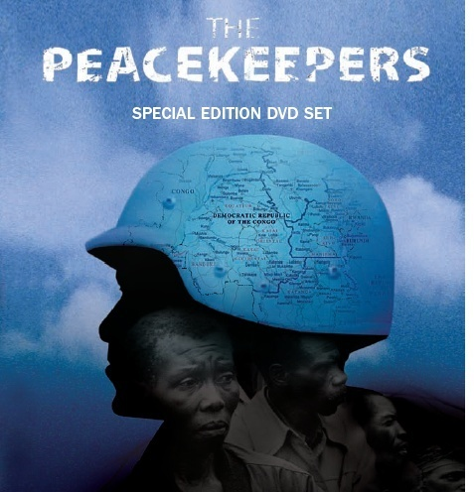
UNITED NATIONS IN DRC

Slide 26
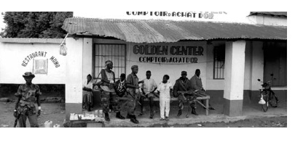
UN FIRST MISSION : 1960-64
ONUC – UNITED NATIONS OPERATIONS IN THE CONGO
SENT ON THE REQUEST OF GOVT OF CONGO ON 12 JUL 1960
UN FIRST MISSION WAS TO MAINTAIN POLITICAL INDEPENDENCE AND TERRITORIAL INTEGRITY BESIDES MAITAINING LAW AND ORDER
THE MAIN MISSION WAS TO PREVENT SECESSION OF KATANGA STATE
AT ITS PEAK THERE WERE 20,000 PEACE KEEPERS IN CONGO
IN FEB 1963, AFTER KATANGA WAS REINTEGRATED , PHASED PULL OUT OF TROOPS COMMENCED
Notes:
26
The United Nations Operation in the Congo (Opération des Nations Unies au Congo, or ONUC), which took place in the Republic of the Congo from July 1960 until June 1964, marked a milestone in the history of United Nations peacekeeping in terms of the responsibilities it had to assume, the size of its area of operation and the manpower involved. It included, in addition to a peacekeeping force which comprised at its peak strength nearly 20,000 officers and men, an important Civilian Operations component. Originally mandated to provide the Congolese Government with the military and technical assistance it required following the collapse of many essential services and the military intervention by Belgian troops, ONUC became embroiled by the force of circumstances in a chaotic internal situation of extreme complexity and had to assume certain responsibilities which went beyond normal peacekeeping duties.
1. Establishment of ONUC
The Republic of the Congo, a former Belgian colony, became independent on 30 June 1960. In the days that followed, disorder broke out, and Belgium sent its troops to the Congo, without the agreement of the Congolese Government, for the declared purpose of restoring law and order and protecting Belgian nationals.
On 12 July 1960, the Congolese Government asked for United Nations military assistance to protect the national territory of the Congo against external aggression. Two days later, the Security Council called upon Belgium to withdraw its troops from the Congo and authorized military assistance as might be necessary until, through the efforts of the Government with the technical assistance of the United Nations, the national security forces might be able, in the Government's opinion, to meet their tasks fully. [The Council resolution was adopted by 8 votes in favour (including the Soviet Union and the United States) to none against, with three abstentions.]
In less than 48 hours, contingents of a United Nations Force, provided by a number of countries including Asian and African States began to arrive in the Congo. At the same time, United Nations civilian experts were rushed to the Congo to help ensure the continued operations of essential public services.
2. Operations
Over the next four years, the task of the United Nations Operations in the Congo was to help the Congolese Government restore and maintain the political independence and territorial integrity of the Congo; to help it maintain law and order throughout the country; and to put into effect a wide and long-range programme of training and technical assistance.
To meet the vast and complex task before it, the United Nations had to assemble a very large team. At its peak strength, the United Nations Force totalled nearly 20,000 officers and men. The instructions of the Security Council to this Force were strengthened early in 1961 after the assassination in Katanga province of former Prime Minster Patrice Lumumba. The Force was to protect the Congo from outside interference, particularly by evacuating foreign mercenaries, and advisers from Katanga and preventing clashes and civil strife, by force if necessary as a last resort.
Following the reconvening of Parliament in August 1961 under United Nations auspices, the main problem was the attempted secession, led and financed by foreign elements, of the province of Katanga. In September and December 1961, and again in December 1962, the secessionist gendarmes under the command of foreign mercenaries clashed with the United Nations Force. Secretary-General Dag Hammarskjöld lost his life on 17 September 1961 in the crash of his airplane on the way to Ndola (in what is now Zambia) where talks were to be held for the cessation of hostilities.
3. Termination of ONUCIn February 1963, after Katanga had been reintegrated into the national territory of the Congo, a phasing out of the Force was begun, aimed at its termination by the end of that year. At the request of the Congolese Government, however, the General Assembly authorized the stay of a reduced number of troops for a further six months. The Force was completely withdrawn by 30 June 1964.
Although the military phase of the United Nations Operation in the Congo had ended, civilian aid continued in the largest single programme of assistance undertaken until that time by the world Organization and its agencies, with some 2,000 experts at work in the nation at the peak of the programme in 1963-196

Slide 27
UN PRESENCE 1999-2012
1999 UNSCR 1258
2000 UNSCR 1291
2002 UNSCR 1445
2003 UNSCR 1493
2005 UNSCR 1635
90 MILOBS
5537 TPS INCL 500 MILOBS
AUTH OF ADDL TPS & ASSIST DDRRR
INTERIM EMERGENCY FORCE IN BUNIA
TEMP INCR OF 300 MIL PERS
2004 UNSCR 1565
INCL 507 CIV POL, AUTH DPLY OF BDE
INCR IN STR OF MILOBS TO 760
2008 UNSCR 1856
2009 UNSCR 1905
2010 UNSCR 1925
2011 UNSCR 1991
90
5537
8500
10800
17000
16700
19815

Slide 28
UN MANDATE (UNSCR 1991)
PROTECTION OF CIVILIANS
ENSURE EFFECTIVE PROTECTION OF CIVILIANS INCLUDING HUMANATARIAN PERSONNEL
ENSURE PROTECTION OF UN PERSONNEL & EQPT
SUPPORT GOVT OF DRC IN PROTECTION OF CIVILIANS
SUPPORT EFFORTS TO BRING PERPETRATORS TO JUSTICE BY EST PSC AND ASSIST FARDC
IMPLEMENT UN SYSTEM WIDE PROTECTION STRAT – JPT, CLA, JIT, SURVEILLANCE CENTRES & WOMEN PROTECTION ADVISORS
CREATE ENVIRONMENT FOR SAFE RETURN OF IDPs
SUPPORT GOVT OF DRC IN MIL OPS AGAINST FDLR, LRA AND OTHER MIL GROUPS
SUPPORT THE COMPLETION ACTIVITIES OF DDR OR EFFECTIVE REINTEGRATION INTO THE ARMY
SUPPORT DDRRR OF FOREIGN ARMED GROUP MEMBERS
Notes:
28

Slide 29
UN MANDATE (UNSCR 1991)
STABILISATION AND PEACE CONSOLIDATION
SUPPORT GOVT OF DRC TO STRENGTHEN AND REFORM SECURITY AND JUDICIAL INSTITUTIONS
ASSIST IN STRENGTHEING MILITARY CAPACITY, INCLUDING MILITARY JUSTICE AND MILITARY POLICE IN LINE WITH ARMY REFORM PLAN 2010
SUPPORT REFORM OF POLICE LED BY GOVT OF DRC
DEVELOP AND IMPLEMENT STRATEGY FOR JUSTICE REFORM IN CONSULTATION WITH CONGOLESE AUTH
ASSIST GOVT OF DRC TO CONSOLIDATE STATE AUTHORITY IN TERRITORY FREED FROM ARMED GROUPS
SUPPORT GOVT OF DRC EFFORTS TO FIGHT ILLEGAL EXPLOITATION AND TRADE OF MINERALS
ASSIST GOVT OF DRC IN ENHANCING DEMINING CAPACITY
SUPPORT THE ORGANISATION AND CONDUCT OF NATIONAL, PROVINTIAL AND LOCAL ELECTIONS THROUGH PROVISION OF TECHNICAL AND LOGISTIC SUPPORT
Notes:
29

Slide 30
ORGANISATION : MONUSCO
Office of Public Information
OFFICE OF SRSG
Conduct and Discipline Unit
Political Affairs Division
SRSG
Mr Roger A Meece
External & Provincial Offices, Eastern Coordination Office
Joint Mission Analysis Cell
COS
DCOS
Sector Security Reform
Joint Operations Center
Legal Advisor Section
DSRSG
(Rule of Law)
Leila Zerrougui
DSRSG
(Humanitarian Coordination)
Fidele Sarassoro
Division of Mission Support
Paul Baudes
Force Commander
Office of Police Commissioner
Force HQ Forward
Electoral Assistance Division
Rule of Law
Bde & Sector HQ
Civil Affairs Office
HIV/AIDS
Human Rights
Military Contingents
Security & Safety Section
DDR/DDRRR
Child Protection Section
Mine Action Liaison Unit
MilObs/MSOs
Gender Issues Unit & Sexual Gender based Violence
UN specialized agencies, funds
and programs
Notes:
30

Slide 31
MANDATE ON GENDER ISSUES

Slide 32
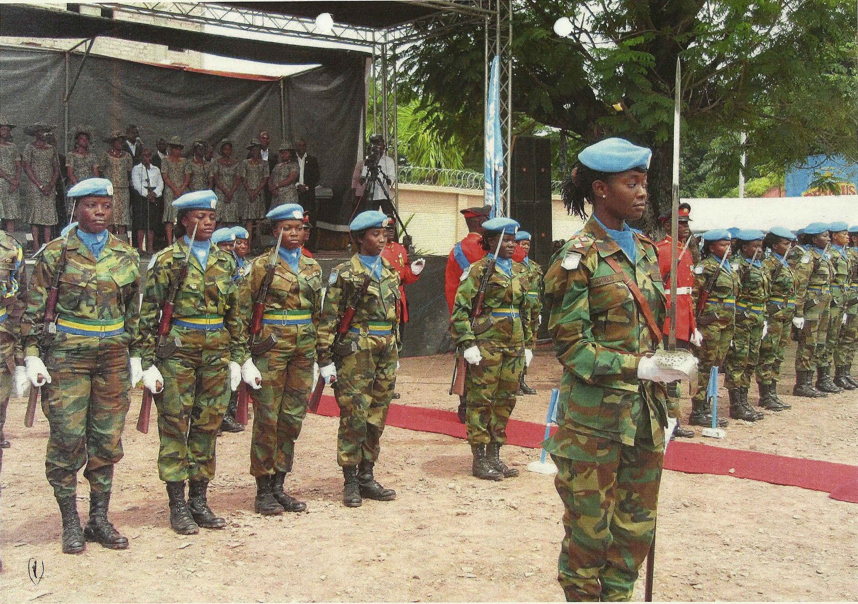

Slide 33
