Slide 1
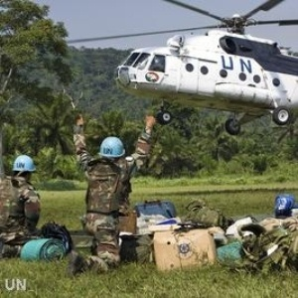
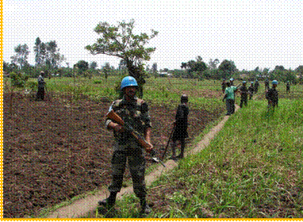
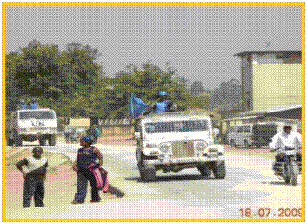
MONUSCO : ROLE OF MILITARY

Slide 2
ORGANISATION : MONUSCO
Office of Public Information
OFFICE OF SRSG
Conduct and Discipline Unit
Political Affairs Division
SRSG
Mr Roger A Meece
External & Provincial Offices, Eastern Coordination Office
Joint Mission Analysis Cell
COS
DCOS
Sector Security Reform
Joint Operations Center
Legal Advisor Section
DSRSG
(Rule of Law)
Leila Zerrougui
DSRSG
(Humanitarian Coordination)
Fidele Sarassoro
Division of Mission Support
Paul Baudes
Force Commander
Office of Police Commissioner
Force HQ Forward
Electoral Assistance Division
Rule of Law
Bde & Sector HQ
Civil Affairs Office
HIV/AIDS
Human Rights
Military Contingents
Security & Safety Section
DDR/DDRRR
Child Protection Section
Mine Action Liaison Unit
MilObs/MSOs
Gender Issues Unit & Sexual Gender based Violence
UN specialized agencies, funds
and programs
Notes:
2

Slide 3
MISSION OBJECTIVES
IN AREAS FREE OF ARMED GROUPS, CONSOLIDATE STATE AUTHORITY THROUGH ESTABLISHMENT OF CIVIL ADMINISTRATION , POLICE & LAW AGENCIES
DRC & RWANDA TO WK TOGETHER ON CLEAR END STATE OBJECTIVES IN RESPECT OF FDLR
PROVIDE TECHNICAL AND LOGISTICAL SUPPORT TO GoDRC FOR THE CONDUCT OF ELECTIONS
ON COMPLETION OF MILITARY OPERATIONS BY FARDC, MINIMISE ARMED GROUP THREATS & RESTORE STABILITY
ENABLE GoDRC TO ESTABLISH SUSTAINABLE SECURITY FORCES TO PROGRESSIVELY TAKE OVER SECURITY DUTIES FROM MONUSCO

Slide 4
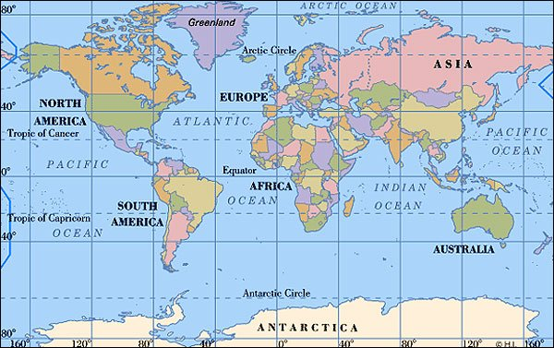
TROOP CONTRIBUTING COUNTRIES
ASIA
Total Strength – 11552
Females - 39
BELGIUM
SERBIA
EUROPE
Total Strength - 28
Females - 02
CHINA
INDIA
PAKISTAN
BANGLADESH
JORDAN
INDONESIA
NEPAL
02
07
FEMALES - 374 (2.2%)
05
02
BENIN
EGYPT
GHANA
MOROCCO
RSA
URUGUAY
GUATEMALA
SOUTH AMERICA
Total Strength – 1331
Females - 86
AFRICA
Total Strength - 3987
Females - 195
TOTAL
Authorized - 19815
MOU - 17033
Deployed - 16971

Slide 5





TCC CONTRIBUTIONS : MONUSCO
 | INDIA | 4027 |  | GHANA | 462
 | PAKISTAN | 3564 |  | BENIN | 450
 | BANGLADESH | 2524 |  | JORDAN | 220
 | URUGUAY | 1181 |  | CHINA | 218
 | RSA | 1239 |  | INDONESIA | 175
 | NEPAL | 1026 |  | GAUTEMALA | 150
 | EGYPT | 1000 |  | BELGIUM | 26
 | MOROCCO | 831 |  | SERBIA | 6
Notes:
5

Slide 6
LATIN AMERICAN TROOPS CONTRIBUTION
URUGUAY
INFANTRY BATTALION | 748
RIVERINE UNIT | 100
ENGINEER COMPANY | 165
WATER TREATMENT PLANT | 28
AIR FIELD SUPPORT UNIT | 94
UTILITY AVIATION UNIT | 46
TOTAL | 1181
GAUTEMALA
SPECIAL FORCES COMPANY | 150
FEMALES - 86 (6.5%)
Notes:
6

Slide 7
MILOBs / MSOs CONTRIBUTING COUNTRIES
NORTH AMERICA
Total Strength - 04
Females - 00
EUROPE
Total Strength – 106
Females - 01
ASIA
Total Strength - 264
Females - 05
LATIN AMERICAN FEMALES - 2 (2.5%)
SOUTH AMERICA
Total Strength - 77
Females -02
AFRICA
Total Strength - 274
Females - 16
FEMALES - 24 (3.3%)
TCCs - 16
MILOBs/MSOs - 50 * (16+34)
TOTAL
Authorized - 760
Deployed - 725

Slide 8
LATIN AMERICAN MILOB CONTRIBUTION
COUNTRY | MILOBS
BOLIVIA | 10
GAUTEMALA | 07
PARAGUAY | 17
PERU | 07
URUGUAY | 36
TOTAL | 77
Notes:
8

Slide 9
Force Task Organization
R
Reserve
Aviation
XXX
Force HQ
SF
Special Forces
2
Medical
Military Police
Engineer
Riverine
X
X
X
X
WEST
ITURI
NORTH KIVU
SOUTH KIVU
KATANGA
SECTOR 2
(-)
(-)
Bénin
Bengladesh
Ghana
Bengladesh x 2
India x 4
Pakistan x 4
Organic Units
Morocco
Népal
RSA
SF
SF
SF
Attached Units
R
Guatémala
Jordan
Egypt
Uruguay
RSA
Uruguay
Bengladesh
Uruguay
Pakistan
Népal
Indonesia
India
Bengladesh
Uruguay
China
R
R
2
Egypt x 2
RSA
Uruguay
China
3
Uruguay
India
2
2
Jordan
Morocco
Ukraine
Notes:
The Force is structured around 17 000 Troops divided into 4 Brigades and 2 Sectors
To meet our mission, the Force has 16 INF BATT, 3 SF Coys (EGY – GUATEMALA-JORDAN) , 6 ENG Coys (NEPAL-INDONESIA-BANGLADESH-URUGUAY-,CHINA-RSAFRICA) 01 URU Riverine Units and 14 military Helicopters. FY: We have recently lost 04 helicopters 5-MI 17
We have two HQs the MAIN one IN KINSHASA and the FWD one IN GOMA.
The GoDRC has requested MONUC to withdraw 2,000 troops by 30 June 2010.
In the framework of the draw down, some units, have already withdraw. I will cover this part at the end of my presentation. After drawdown we will have effectively Inf 16 Bns
1-SENBATT 458 Kisangani
2-TUNBATT 464 Kinshasa
3-BENBATT 747 Kalemie
4-BOLIVIA 200 Bukavu
5-URU RIVERINE 2 108 Entebbe
Total- 1977

Slide 10
FORCE CAPCITY
MANOEUVRE UNITS
  17 X INFANTRY BATTALIONS
FORCE MULTIPLIERS
  3 X SPECIAL FORCES COMPANIES
  6 X AVIATION UNIT S
  1 X RIVERINE COMPANY
FORCE ENABLERS
  6 ENGINEER COMPANIES
  WATER TREATMENT UNITS
  AIR FIELDD SUPPORT UNITS
  MILITARY POLICE DETACHMENTS
  MEDICAL; 3 X LEVEL II HOSPITALS AND 1 X LEVEL III HOSPITAL.
  MILITARY TRAINING TEAM
  48 MILITARY OBSERVER TEAM SITES
  MONUSCO CIVIL TRANSPORT AIRCRAFT (1 X AN-72, 3 X IL-76, 6 x C130, 4 x MI-26, 30 x MI-8, 2 x BOEING 737 & 3x CRJ 200)
Notes:
10

Slide 11
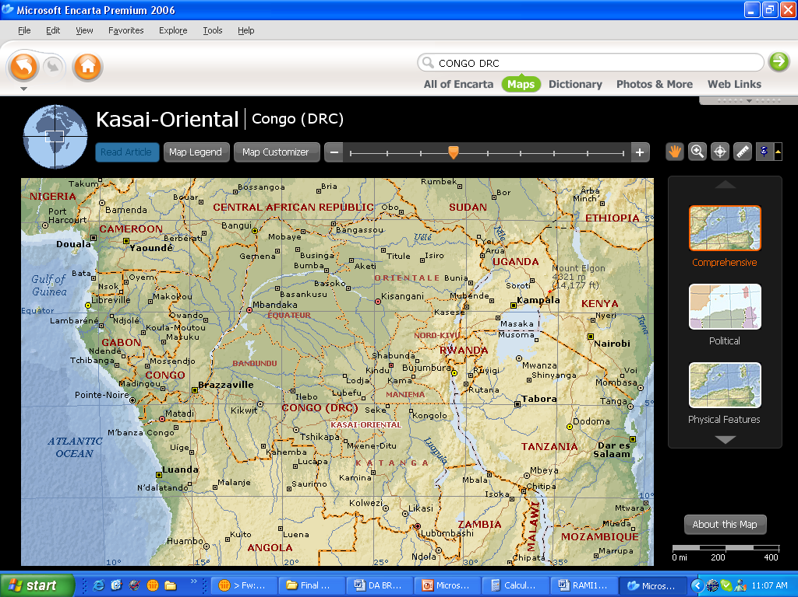
DEPLOYMENT OF CONTINGENTS
Ituri Bde
Strength - 3539
Sector 2
Strength - 326
21%
2%
35%
North Kivu
Strength – 6092
34%
South Kivu
Strength -5806
Western Bde
Strength - 809
5%
3%
Katanga Bde
Strength - 450
Authorized - 17200
Deployed - 16971

Slide 12
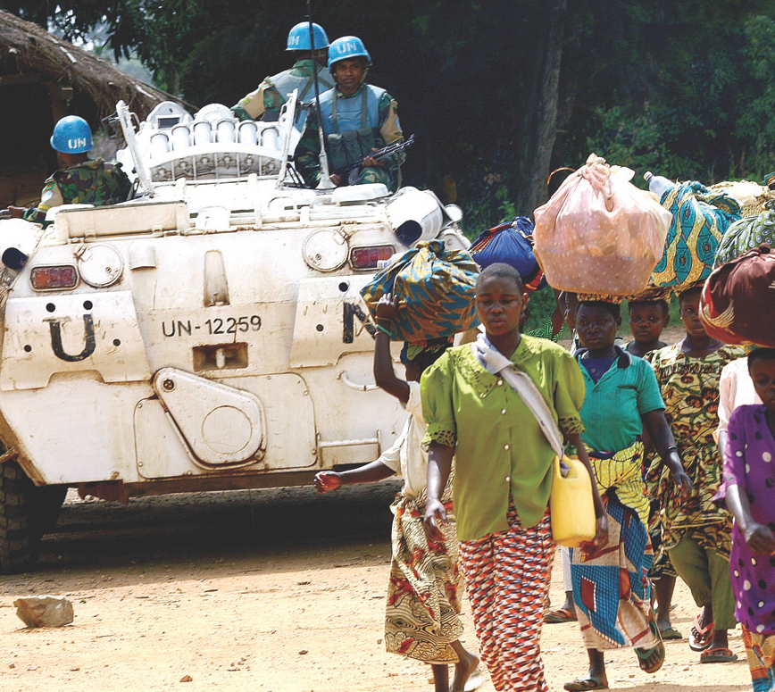
ROLE OF MILITARY IN POC
Notes:
12

Slide 13
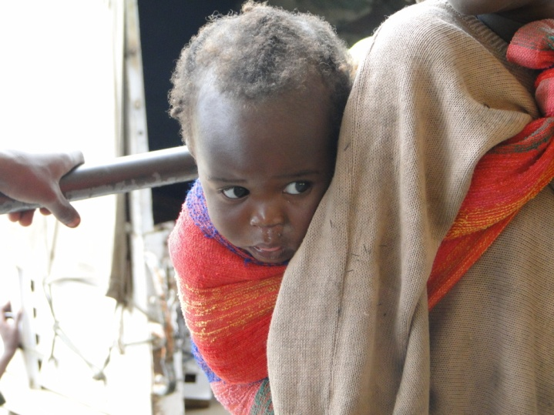
THREATS TO POPULATION
PROLIFERATION OF WEAPONS
ETHNIC DIFFERENCES
INEFFECTIVE LAW AND ORDER
IDEOLOGICAL DIFFERENCES
DEMOBILISED SOLDIERS
UNEMPLOYED YOUTH
ILL DISCIPLINED FARDC / PNC
POPULATION
POROUS BORDERS
RETURN OF IDPs/REFUGEES - LAND CONFLICTS
ECONOMIC INTERESTS OF KEY PLAYERS
ARMED GROUPS
IMPUNITY OF STATE & NON-STATE ACTORS FOR HR VIOLATIONS

Slide 14
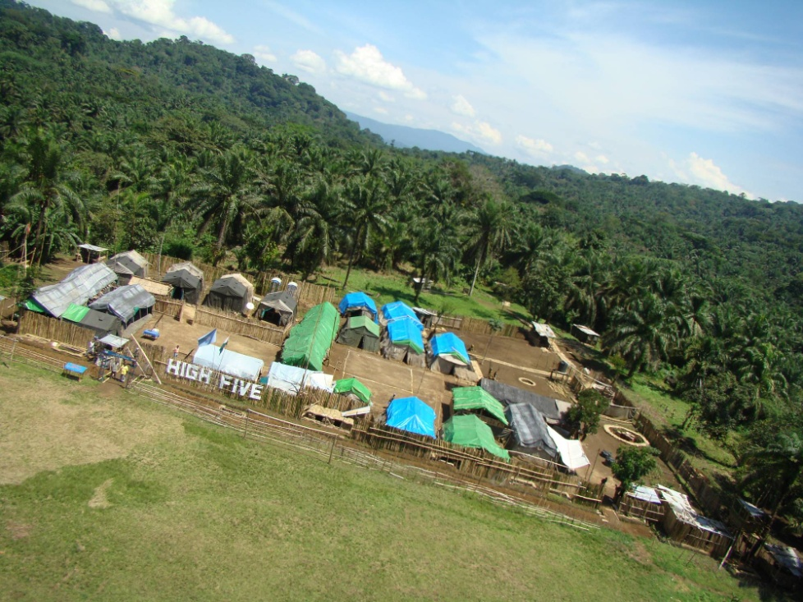
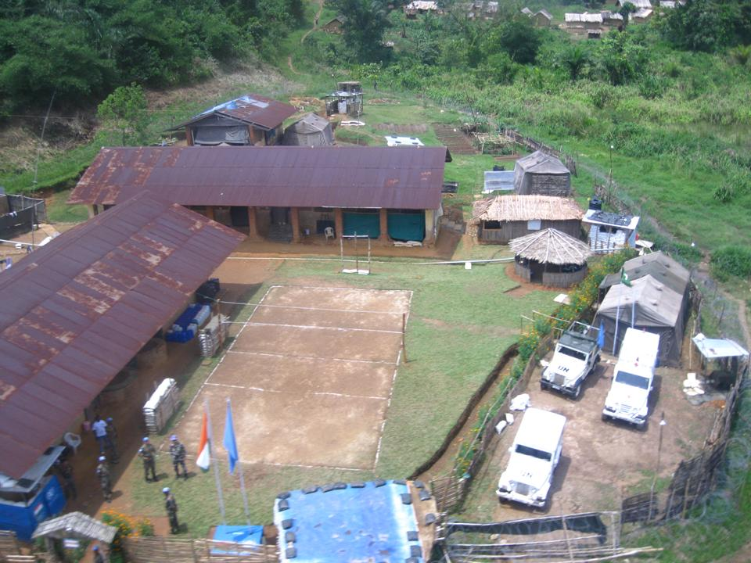
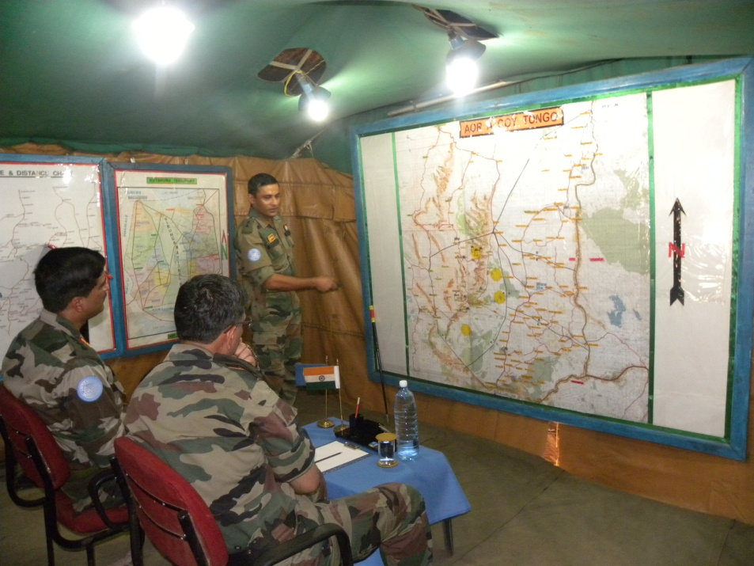
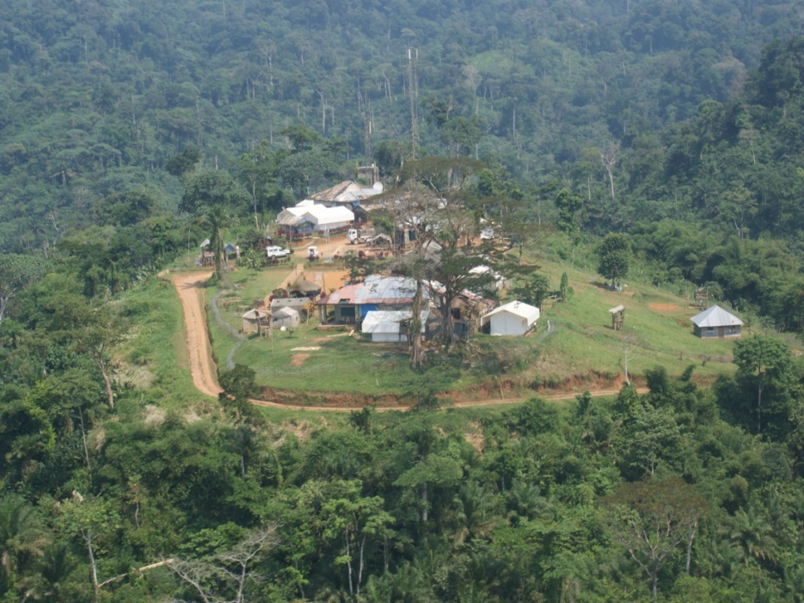
OCCUPATION OF COBs/TOBs
NTOTO
KIBUA
TONGO
WALIKALE

Slide 15
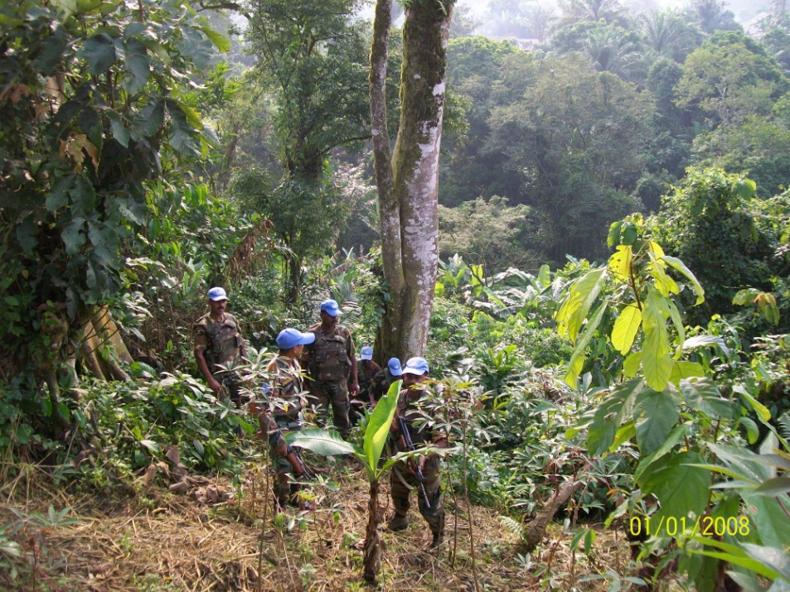
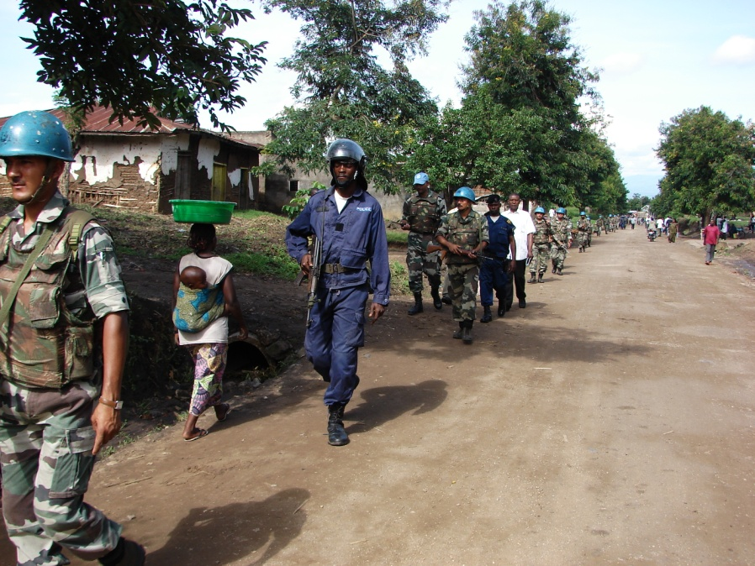
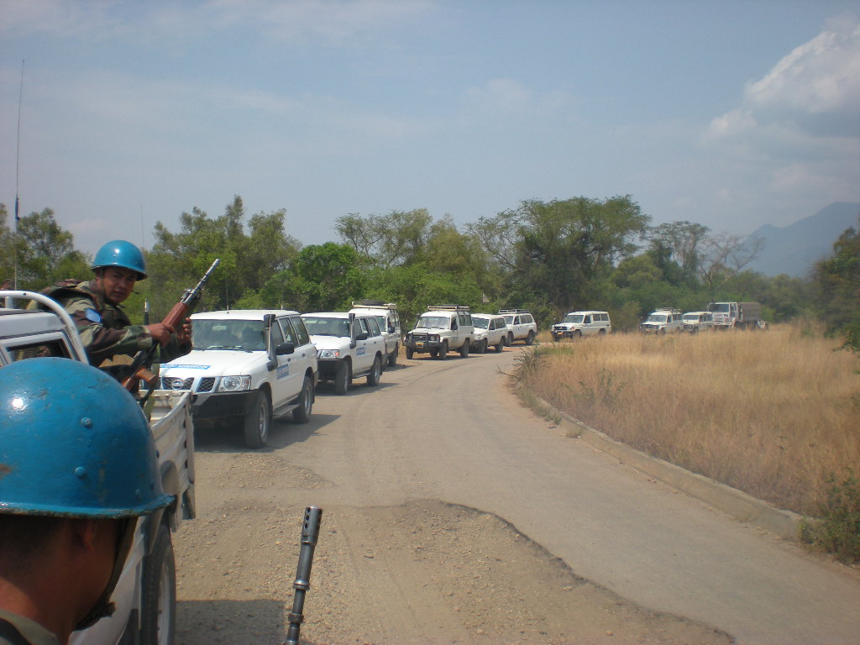
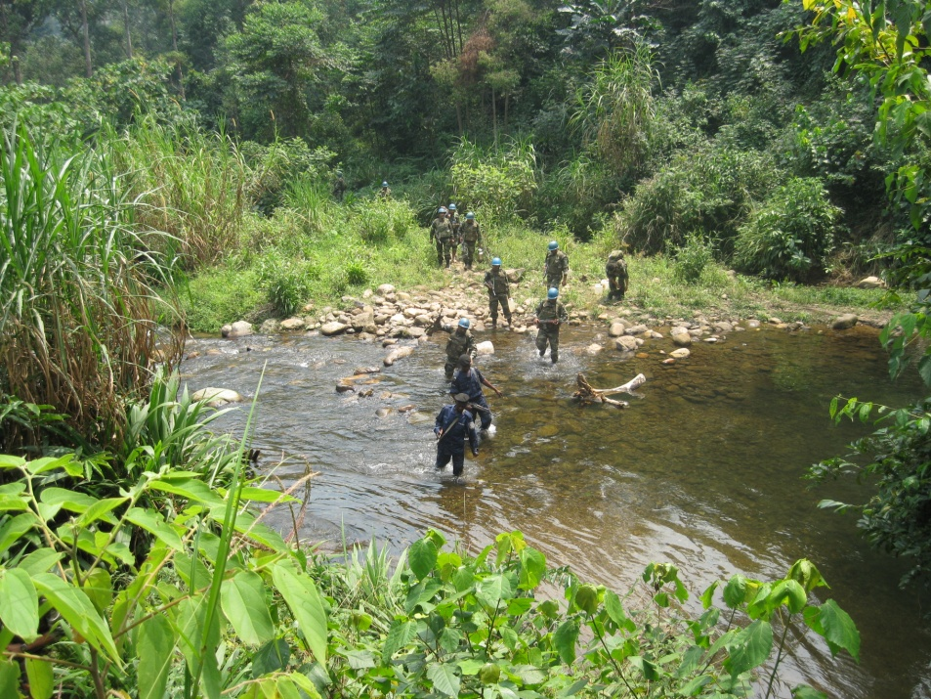
PTLS

Slide 16
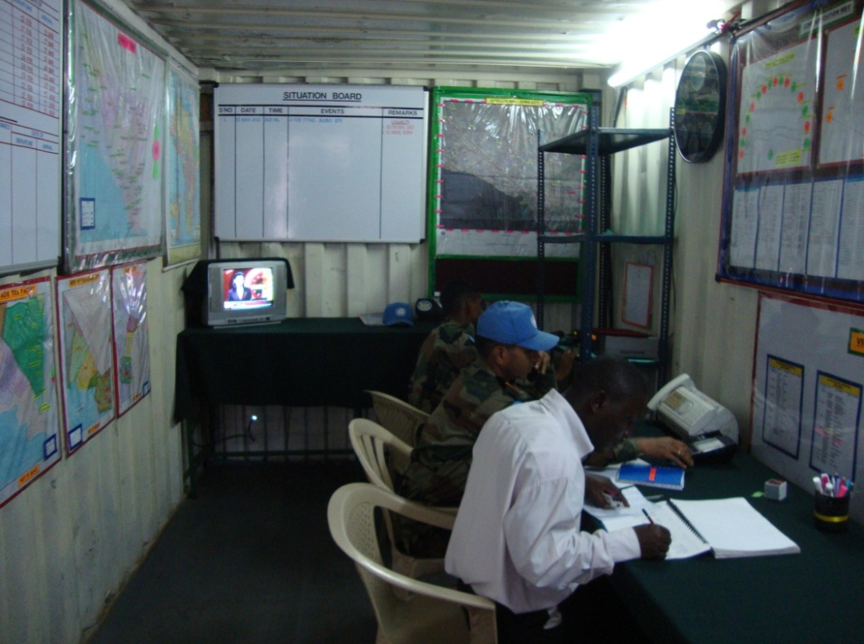
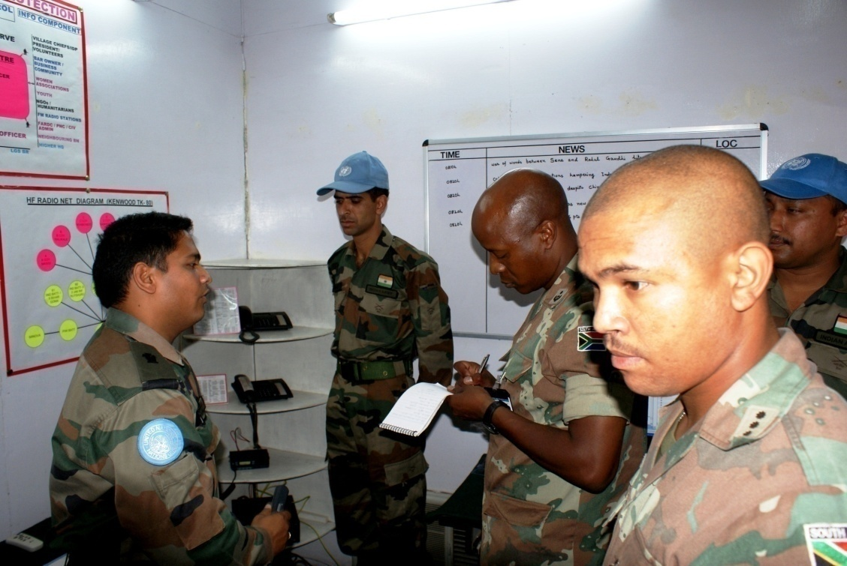
SVL CENTRES

Slide 17
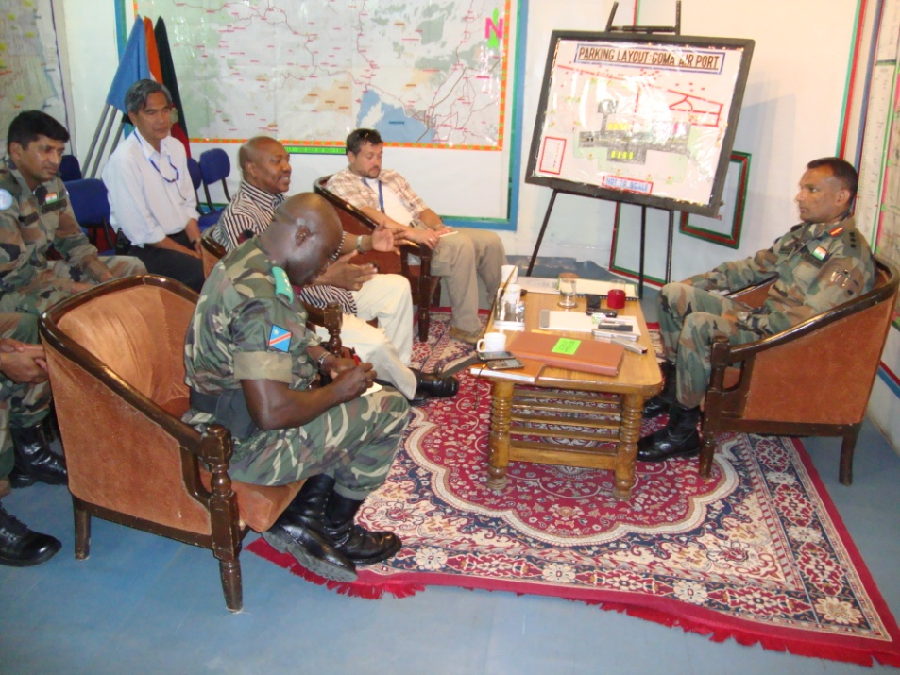
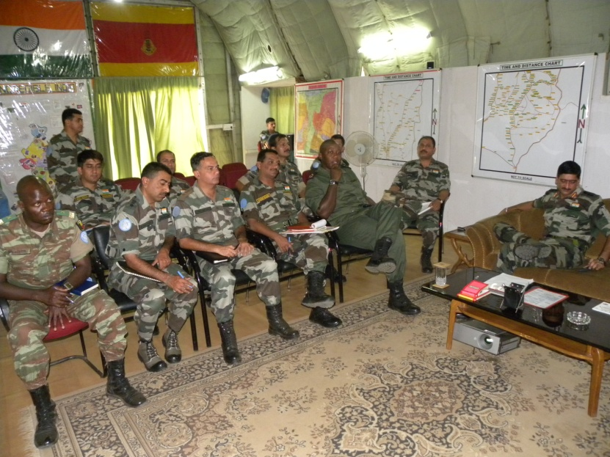
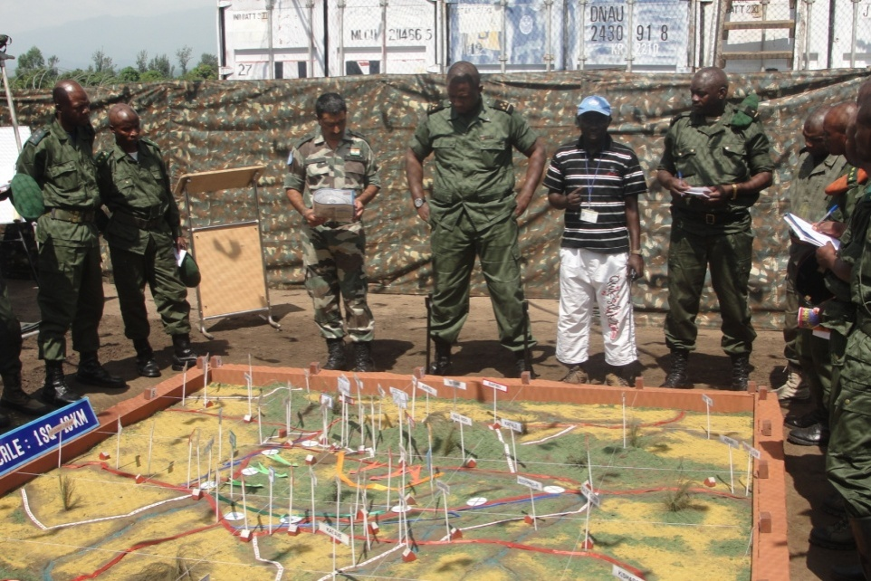
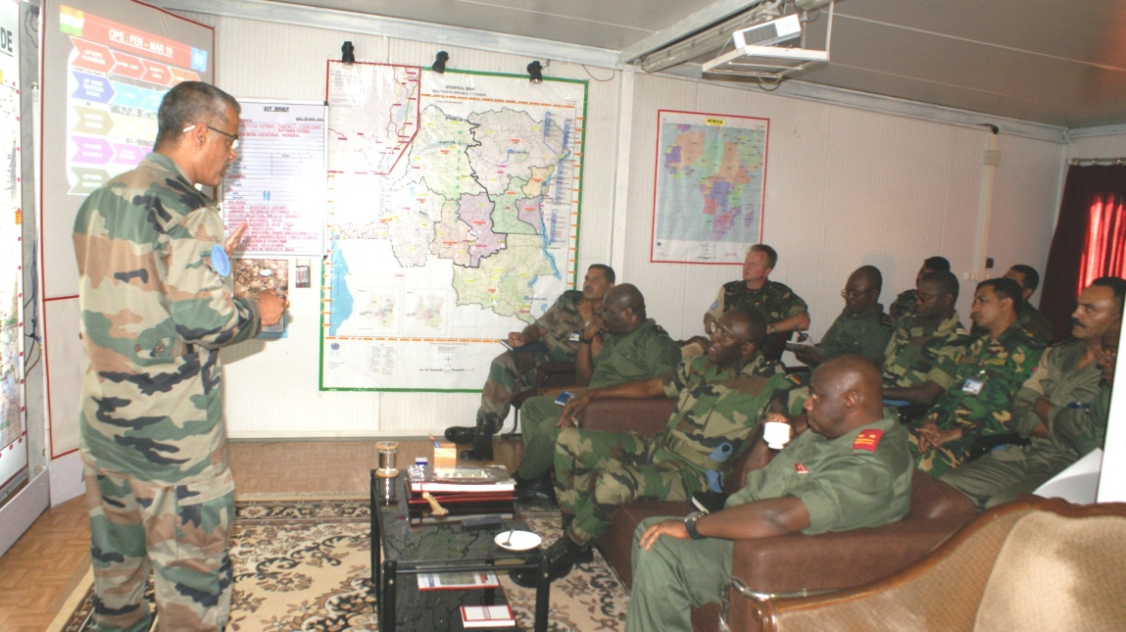
JT PLG OF OPS

Slide 18
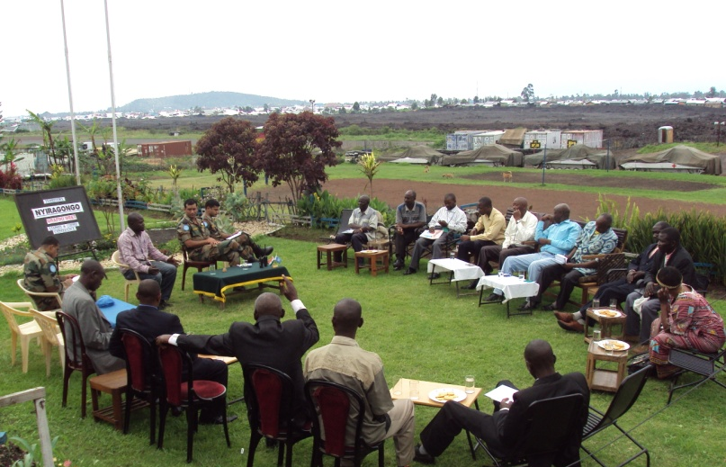
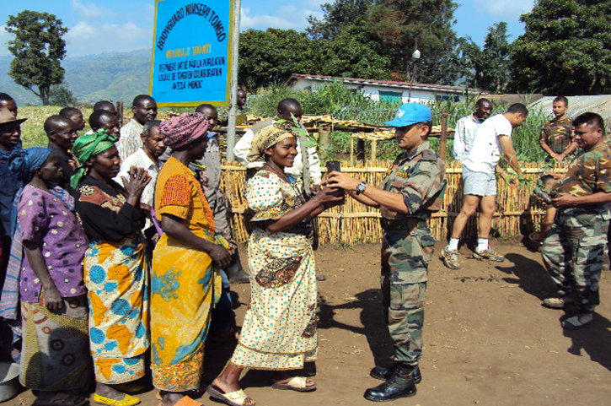
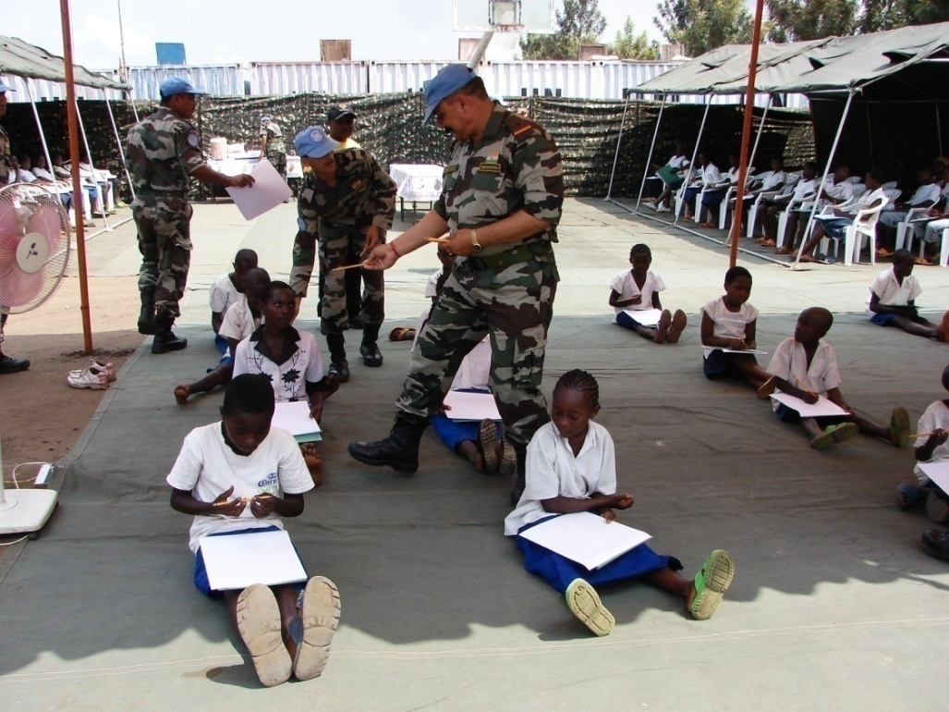
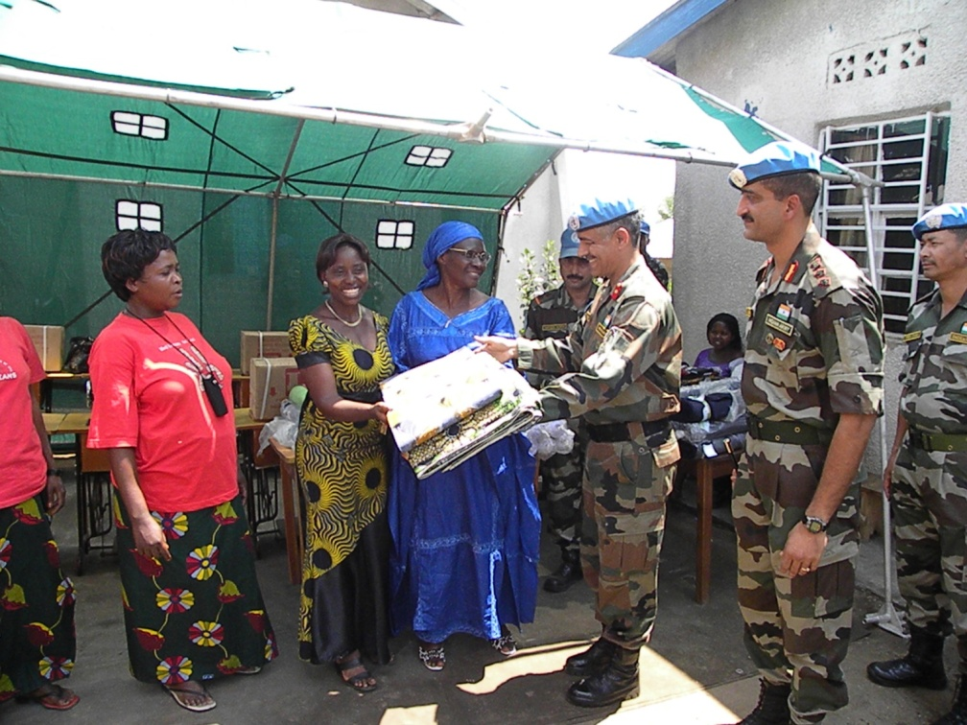
MANAGING THE ENVT

Slide 19
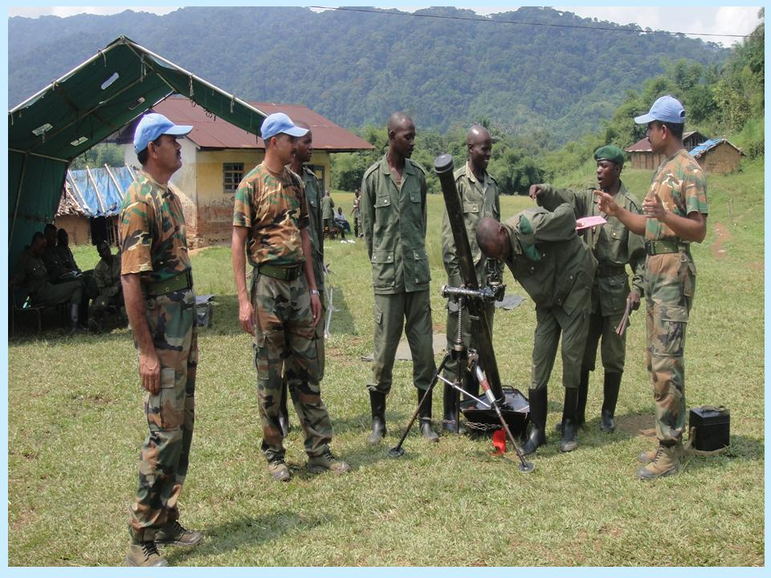
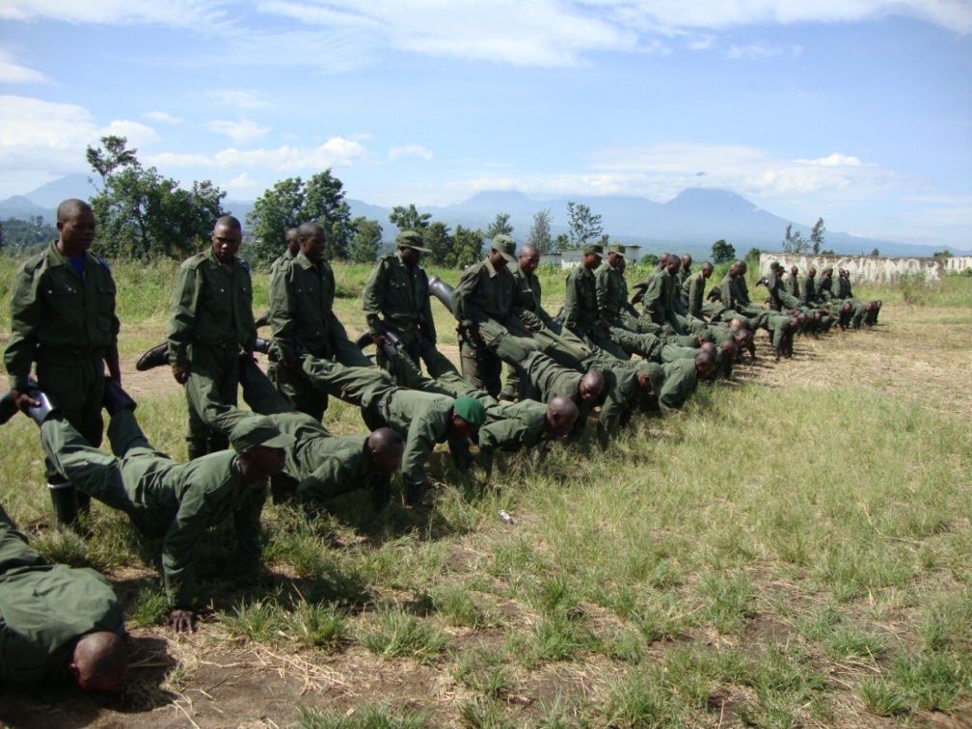
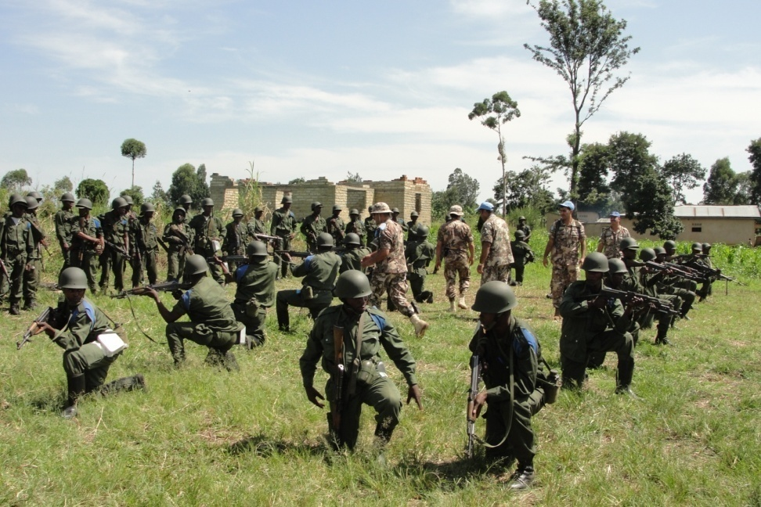
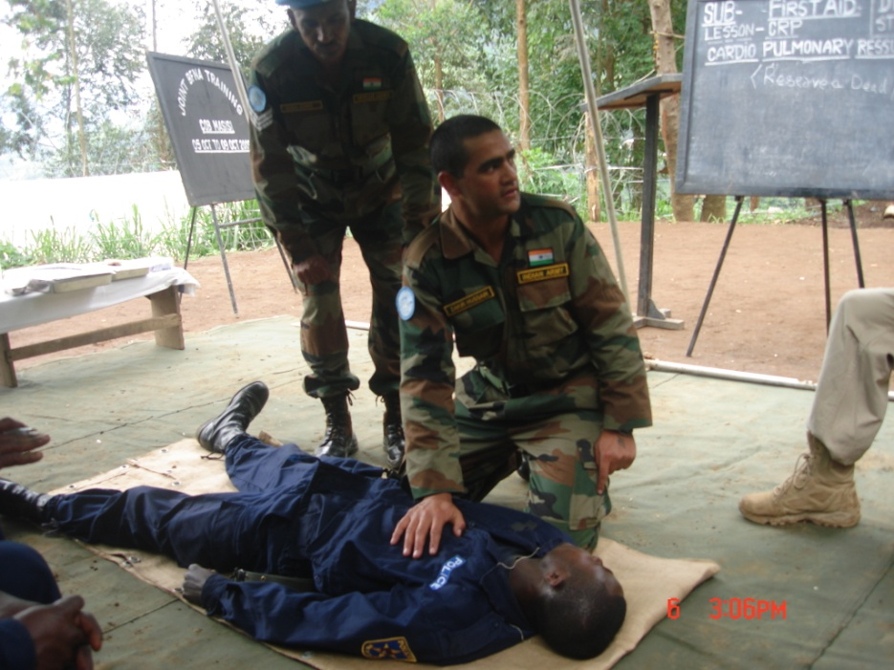
TRG OF FARDC/ PNC

Slide 20
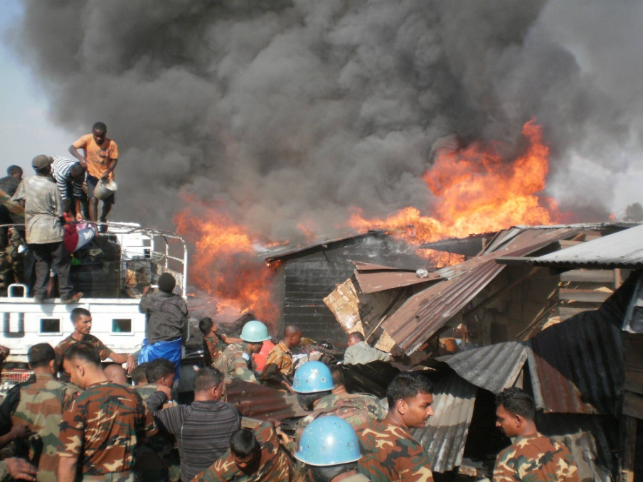
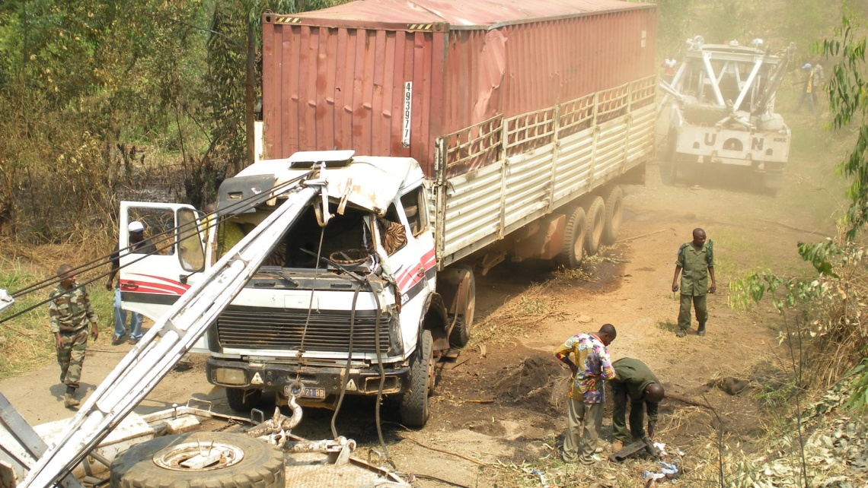
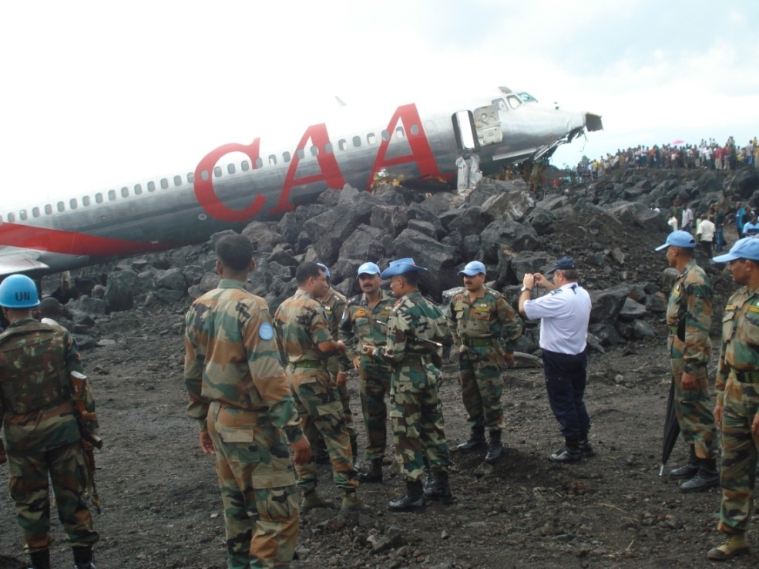
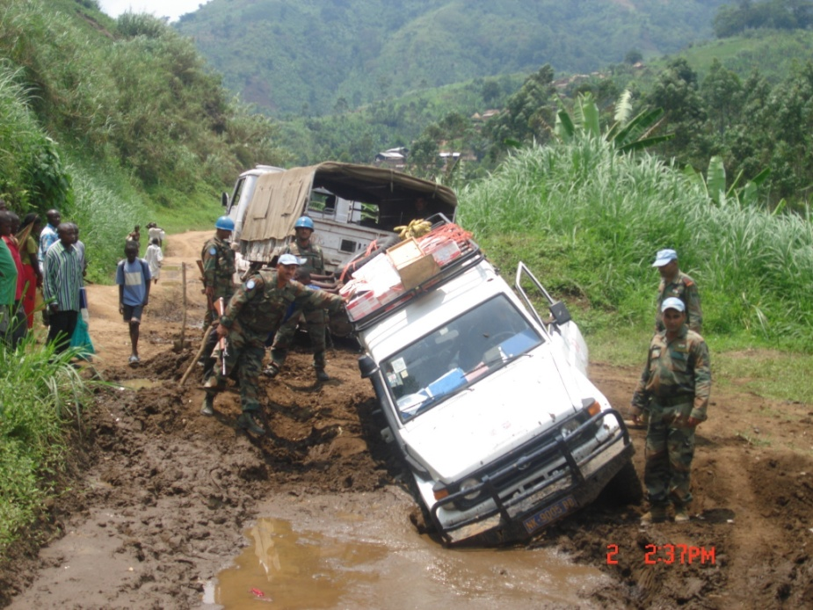
HUMANITARIAN ASSISTANCE

Slide 21
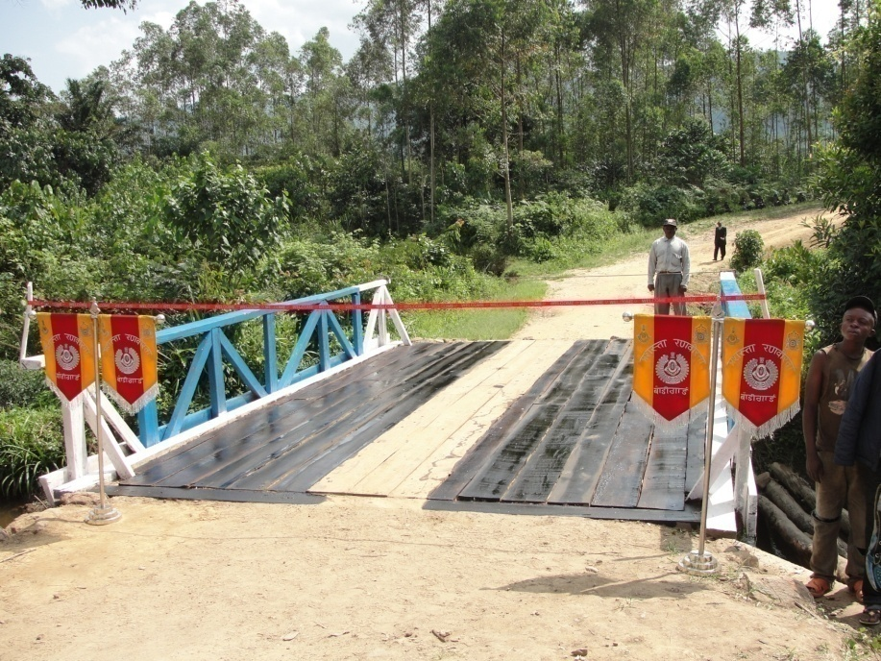
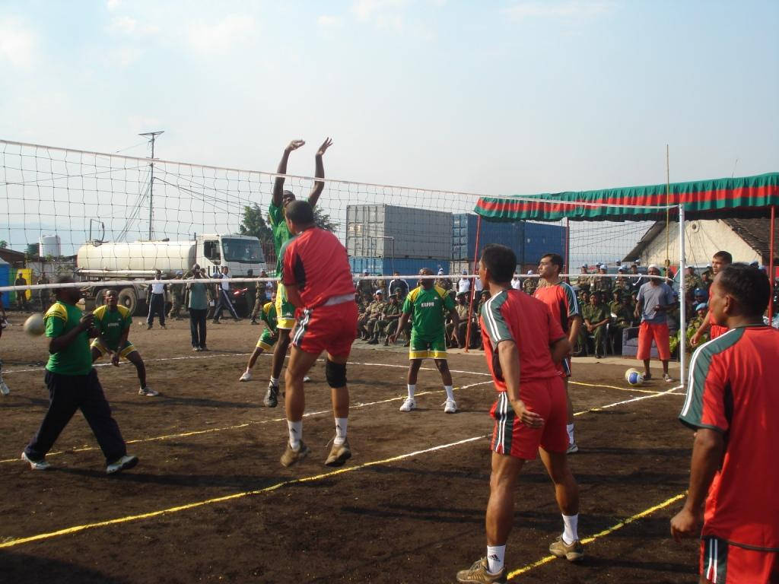
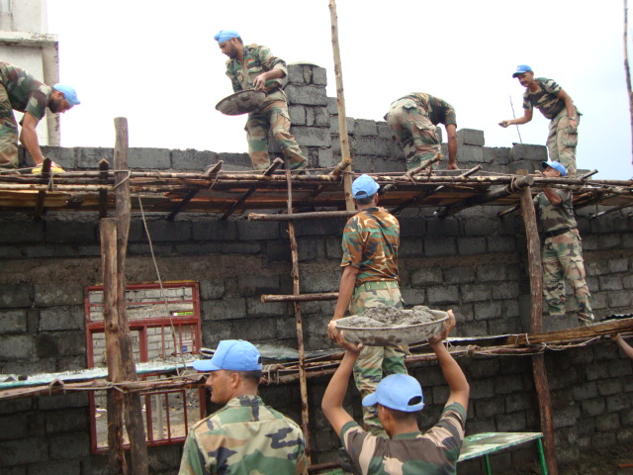
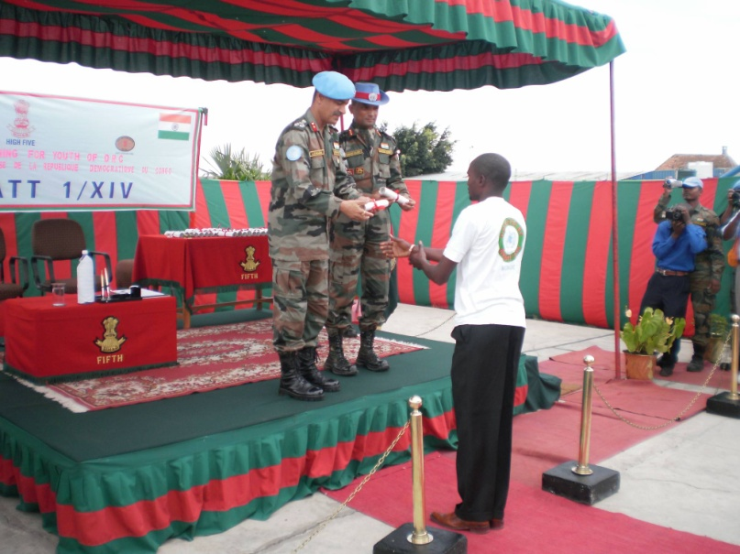
WHAM MEASURES

Slide 22
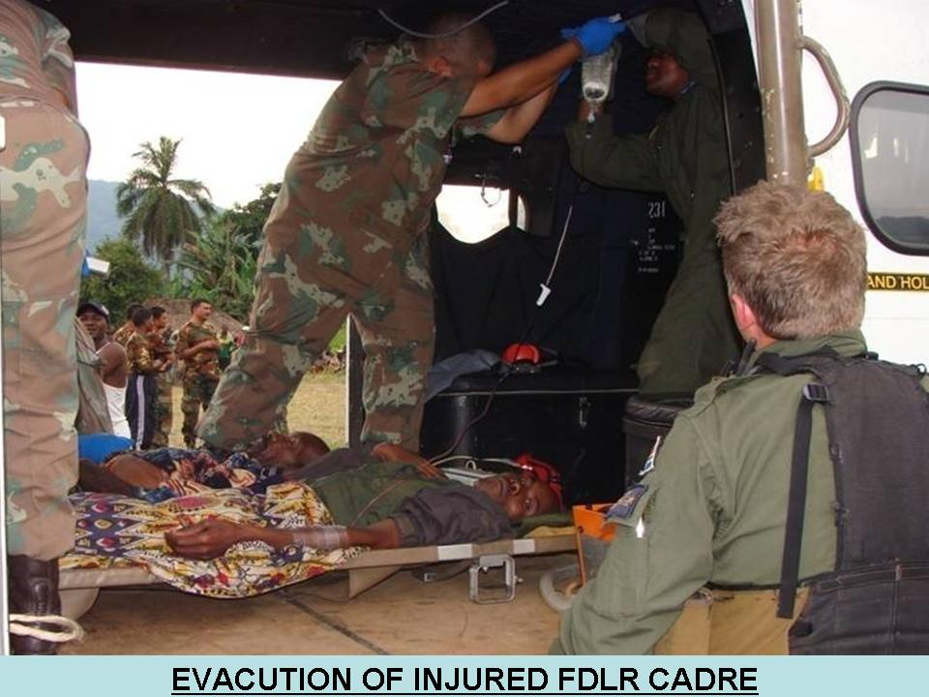
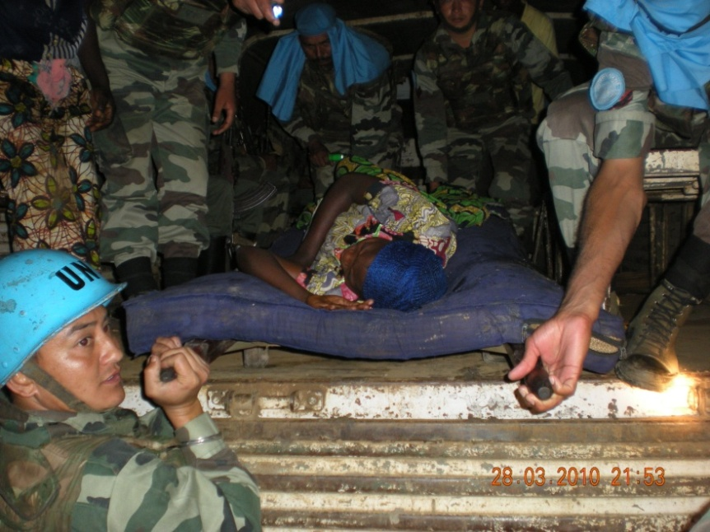
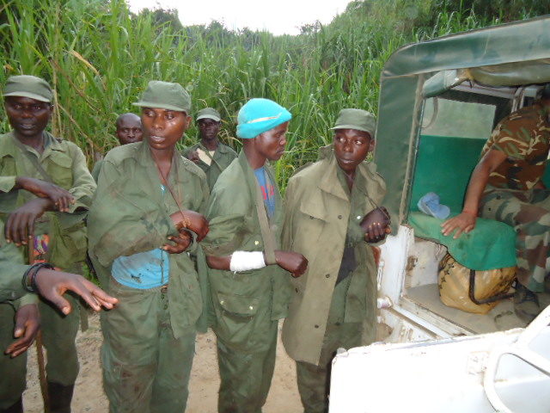
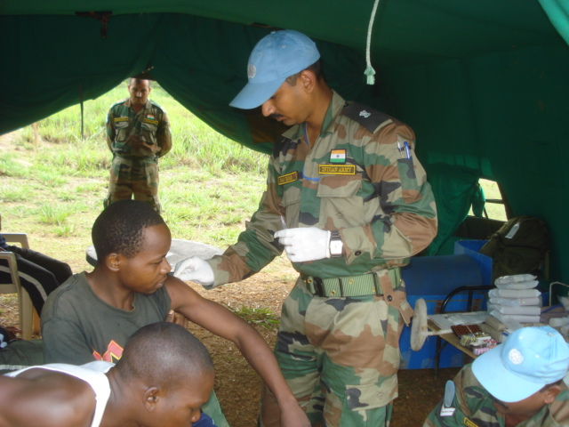
MED ASSISTANCE

Slide 23
EXAMPLE
SITUATION
INFORMATION IS RECEIVED AT A COB OF AN IMMENENT
ARMED GROUP ATTACK ON A VILLAGE
COB INFORMS THE BATTALION HEADQUARTERS
BATTALION COMMANDER DECIDES TO PROVIDE
PROTECTION BY SENDING A QUICK REACTION FORCE
(QRF) FROM THE TOB
HELICOPTERS ARE DISPATCHED FROM AIR BASE TO
THE COB
TROOPS EMPLANE AT TOB AND QRF IS DISPATCHED
Notes:
23

Slide 24
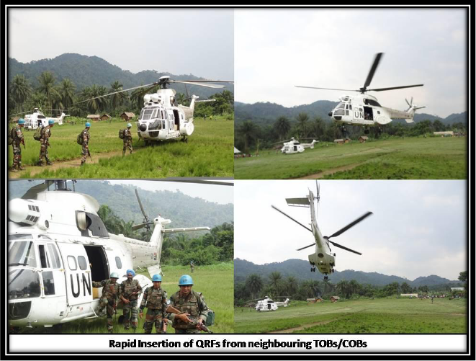

Slide 25
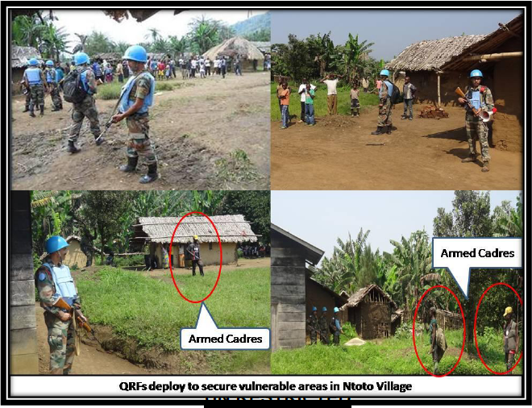

Slide 26
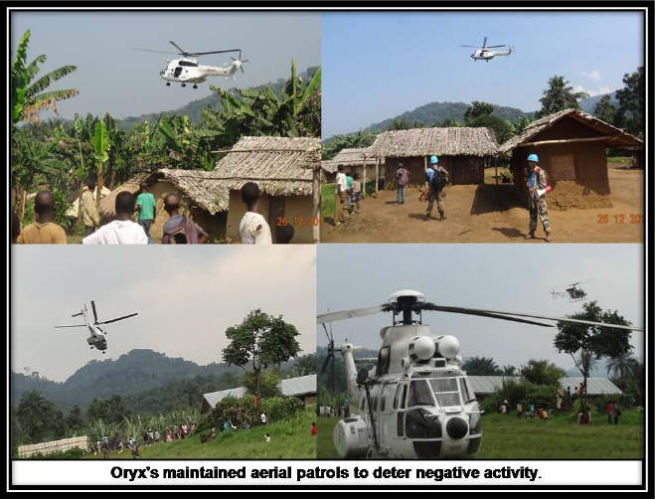

Slide 27
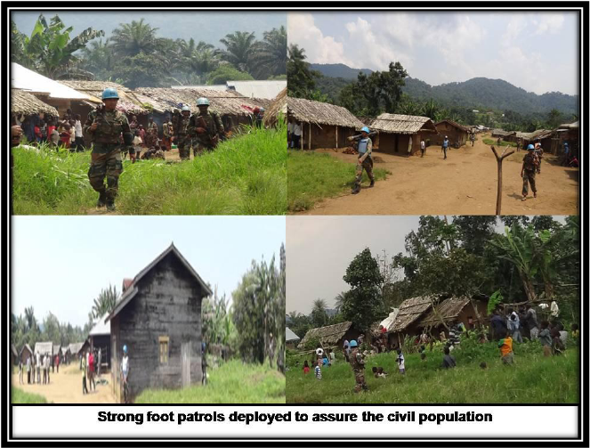

Slide 28
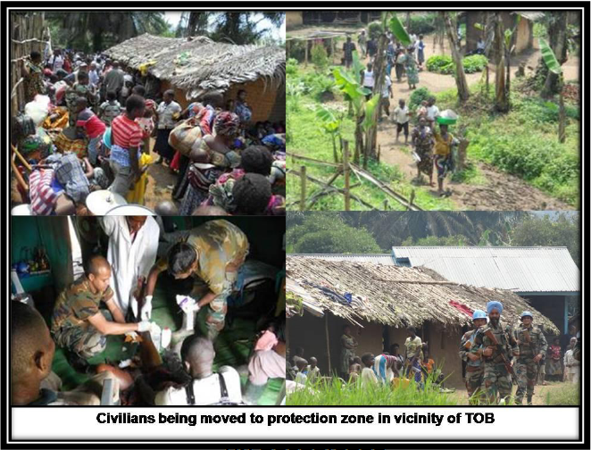

Slide 29
MONUSCO
MILITARY RESPONSES : PROTECTION OF CIVILIANS
Notes:
29

Slide 30
PROTECTION OF CIVILIANS
SITUATION | MILITARY RESPONSE
MASS VIOLENCE & TARGETTING OF CIVILIANS | INTERVENE AND NEGOTIATE IF REQUIRED, USE FORCE AGAINST ARMED ELEMENTS STOP ADVANCE OF ARMED ELEMENTS
IDPs & CIVILIANS FLEEING | SECURE SAFETY OF POPULATION IN FLIGHT IDENTIFY AND ISOLATE ARMED ELEMENTS STOP ADVANCE OF ARMED ELEMENTS
CIVILIANS GATHERING AROUND COB / TOB | ASSESS SECURITY THREATS (ELDERS, WOMEN & CHILDREN) ESTABLISH EMERGENCY COMMUNICATION IDENTIFY SAFE AREAS AND CONTINGENCY PLANS
SECURITY OF IDP CAMPS AND SETTLEMENTS | ASSESS PHYSICAL SECURITY THREATS WITH IDP REPS – ELDERS, WOMEN &CHILDREN PROVIDE SECURITY PATROLS COORDINATE WITH IDP REPS, PNC/ FARDC PATROL AREA – FIREWOOD, WATER & FOOD IS COLLECTED BY IDPs
Notes:
30

Slide 31
CHILD PROTECTION
SITUATION | MILITARY RESPONSE
ARMED GROUPS ROUNDING UP YOUTH – KIDNAPPING / RECRUITING | QUESTION ARMED GROUP ABOUT THEIR ACTIONS PREVENT THEM FROM DOING SO REMIND THEM IT IS ILLEGAL DOCUMENT ACTIVITY – PHOTO, STATEMENTS, LOGS REFER TO CHILD PROTECTION
YOUTH IN CUSTODY – POTENTIAL HARM | INTERVENE AND BRING YOUTH TO SAFETY DOCUMENT ACTIVITY – PHOTOS, STATEMENTS, LOGS REFER TO CHILD PROTECTION
Notes:
31

Slide 32
SEXUAL VIOLENCE
SITUATION | MILITARY RESPONSE
INFORMATION RECEIVED OF SEXUAL VIOLENCE | RECORD INFORMATION ACCURATELY INFORM HUMAN RIGHTS, GENDER, SEXUAL VIOLENCE AND CHILD PROTECTION FOCAL POINTS
IN A SITUATION WHERE SEXUAL VIOLENCE HAS BEEN COMMITTED OR GOING TO BE COMMITTED | INTERVENE TO PREVENT DETAIN OFFENDER BRING VICTIM OF CRIME TO SAFETY REPORT TO HIGHER HQ, PNC AND / OR FARDC INFORM SEXUAL VIOLENCE FOCAL POINT OFFICER
Notes:
32

Slide 33
MONUSCO
MECHANISMS FOR PROTECTION OF CIVILIANS
Notes:
33

Slide 34
JOINT ASSESSMENT MISSION
FACTORS | DESCRIPTION
OBJECTIVE | GENERAL EVALUATION OF THE HUMANATARIAN, PROTECTION, DEVELOPMENT, HUMAN RIGHTS AND/OR SOCIO-POLITICAL SITUATION IN A SPECIFIC AREA AND MAKE RECOMMENDATIONS
COMPOSITION | HUMAN RIGHTS ; CIVIL AFFAIRS SECTION ; CHILD PROTECTION SECTION; POLITICAL AFFAIRS DIVISION ; OCHA; JMAC ; NGOs ; CIVIL SOCIETY & LOCAL AUTHORITIES
ROLE | PREVENTIVE AND PROACTIVE MECHANISM
DURATION | 1-2 DAYS
Notes:
34

Slide 35
JOINT PROTECTION TEAM
FACTORS | DESCRIPTION
OBJECTIVE | ADDRESS PROTECTION NEEDS OF COMMUNITY WORKING WITH MILITARY COMANDERS AND LOCAL COMMUNITIES ACTIVATE COORDINATION MECHANISMS BETWEEN LOCAL COMMUNITIES, LOCAL AUTHORITIES AND MONUSCO DEVELOP LOCAL CONTINGENCY PLANS OFFER PROTECTION ADVICE
COMPOSITION | CIVIL AFFAIRS SECTION (LEAD); CHILD PROTECTION SECTION ; DDRRR ; GENDER ; HR ; JMAC & UNPOL
ROLE | PREVENTIVE AND PROACTIVE SET UP ALERT MECHANISMS AND PROTECTION PLANS
DURATION | 4-10 DAYS
Notes:
35

Slide 36
JOINT INVESTIGATION TEAM
FACTORS | DESCRIPTION
OBJECTIVE | SUPPORT CONGOLESE JUSTICE IN CONDUCTING INVESTIGATIONS ON ALLEGED HUMAN RIGHTS VIOLATIONS ALLEGEDLY COMMITTED IN REMOTE/ INACCESSIBLE AREAS PURSUE ALLEGED PERPETRATORS OF SUCH VIOLATIONS PROTECTION OF VICTIMS, WITNESSES AND HUMAN RIGHTS DEFENDERS
COMPOSITION | JHRO (LEAD) ; FARDC –MILITARY PROSECUTORS OR INSPECTORS & CHILD PROTECTION SECTION
ROLE | POST-FACTO INTERVENTION
DURATION | 1-3 DAYS
Notes:
36

Slide 37
JOINT MONITORING TEAM
FACTORS | DESCRIPTION
OBJECTIVE | DEPLOYED IN SUPPORT OF MONUSCO STRATEGY TO RESTORE STATE AUTHORITY BY DEPLOYING PNC UNITS, GOVERNMENT AND JUSTICE DELEGATES TO STABILISED ZONES IN EASTERN PROVINCES AFTER DISENGAGEMENT OF ARMED GROUPS IS COMPLETED OBSERVE, SUPERVISE AND MONITOR FUNCTIONING OF ALL CONGOLESE CIVIL SERVANTS
COMPOSITION | UNPOL AND CIVILIAN OBSERVERS SECONDED BY FOLKE BERNADOTTE ACADEMY THROUGH UNDP (UNDER AUTHORITY OF POLICE COMMISSIONER)
ROLE | MONITOR, SUPPORT AND ADVISE THE PUBLIC SERVICES- POLICE, CIVIL ADMINISTRATION AND JUSTICE DEPARTMENTS
Notes:
37

Slide 38
GENDER EXPERIENCE : MONUSCO

Slide 39
MILOBS
24 FEMALE MILOBS IN MISSION – 16 DEPLOYED IN TEAM SITES
FEMALE MILOBS ARE DEPLOYED IN PAIRS – RAINBOW CONCEPT
VALUE ADDITION TO TEAM SITES WITH FEMALE MILOBs
  CONSULT WITH LOCAL WOMEN – INFORMATION GATHERING
  ASSIST IN IDENTIFICATION OF PATROL ROUTES BASED ON THREATS TO WOMEN
  MIXED PATROLS – BETTER INTERACTION WITH LOCALS
  INCREASED OUTREACH TO WOMEN AND CHILDREN
  GREATER OUTREACH IN ASSISTANCE TO VICTIMS OF HRV AND SEXUAL VIOLENCE
Notes:
39

Slide 40
CONTINGENTS
FEMALES ARE GENERALLY PART OF SUPPORT/
ENABLING UNITS – MEDICAL UNITS, AIR FIELD
SUPPORT UNITS, AMET etc.
CONTRIBUTION IS FIELD UNITS IS REQUIRED TO BE ENHANCED
VALUE ADDITION TO COBs WITH FEMALES
  PATROLLING ACTIVITIES – INCREASED OUTREACH
  CHECK POINTS – REPECTFUL CONDUCT WITH LOCAL WOMEN
  PROTECTION TASKS – VULNERABLE POPULATION LIKE PREGNANT WOMEN, ELDERS AND CHILDREN
  ASSISTANCE IN SECURITY SUPPORT TASKS – DDR, ELECTIONS, SUPPORT TO FARC etc
  MONITORING AND VERIFICATION TASKS
  MILITARY LIAISON TASKS
Notes:
40

Slide 41
MONUSCO
WAY FORWARD
Notes:
41

Slide 42
MILITARY PROTECTION TASKS
ADVISE ON PROTECTION REQUIREMENTS OF WOMEN AND GIRLS IN IDP CAMPS & SETTLEMENTS
ADVISE ON PROTECTION REQUIREMENTS OF VULNERABLE POPULATION – ELDERLY PEOPLE, PREGNANT WOMEN AND CHILDREN
PROVIDE SUPPORT TO VICTIMS OF SEXUAL VIOLENCE
Notes:
42

Slide 43
MILITARY SUPPORT ACTIVITIES
DISARMAMENT, DEMOBILISATION AND RESETTLEMENT
ADVISE ON LIVING REQUIREMENT OF FEMALE EX-COMBATANTS
ADVISE ON SECURITY REQUIREMENT OF WOMEN TO MITIGATE RISK OF SEXUAL VIOLENCE
ADVISE ON MEDICAL REQUIREMENTS OF FEMALE EX-COMBATANTS AND VICTIMS OF RAPE
ELECTORAL SECURITY
MIXED MILITARY TEAMS AS OUTREACH TO FEMALE VOTERS
SUPPORT TO NATIONAL SECURITY FORCES
MENTORING, ADVISORY AND TRAINING SUPPORT – HOST COUNTRY
MEASURES TO PERVENT AND ADDRESS SEXUAL HARASSMENT
GENDER EQUALITY AND EQUAL RIGHTS TO WOMEN
MISSION SUPPORT
EQUAL PREFERENCE TO BOTH GENDERS FOR ALL TASKS
ACCOMODATION AND BATHROOM FACILITIES FOR WOMEN
GYNAECOLOGICAL FACILITIES AT LEVEL III HOSPITAL
Notes:
43

Slide 44
MONITORING & VERIFICATION ACTIVITIES
PATROLLING, INVESTIGATION AND INFORMATION OPERATIONS
CONSULT WITH LOCAL WOMEN AND WOMENS’ ORGANISATIONS AS PART OF INFORMATION GATHERING ACTIVITIES
CONSULT WITH WOMEN ASKING THEM TO CONTRIBUTE ESTABLISHMENT OF VERIFICATION AND MONITORING COMMISSIONS
EMPLOY JOINT ASSESSMENT TEAMS TO DEFINE PATROLLING ROUTES, IN CONSULTATION WITH LOCAL WOMEN TO ENSURE THEIR SECURITY
FEMALE UNIFORMED PEOPLE MAY BE DEPLOYED TO DISSEMINATE NON-SENSITIVE INFORMATION ON PLANNED OPERATIONS AND MILITARY ACTIVITIES
MIXED TEAMS OF MILITARY INVESTIGATORS– CONFIDENCE BUILDING : MORE CONFORTABLE CONFIDING IN FEMALE COUNTERPARTS
LOCAL FEMALE INTERPRETERS – INCREASE OUTREACH TO WOMEN AND CHILDREN
COOPERATION WORKING WITH OTHER UN AGENCIES AND NGOs
Notes:
44

Slide 45
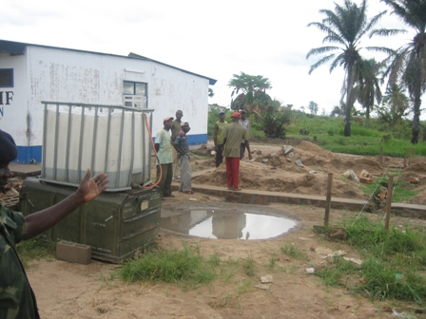
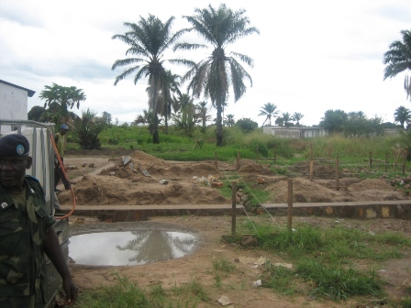
GENDER SPECIFIC QIP
CONSTRUCTION OF A MATERNITY WARD IN PROGRESS AT CAMP MARIN, KALIME
Notes:
45

Slide 46
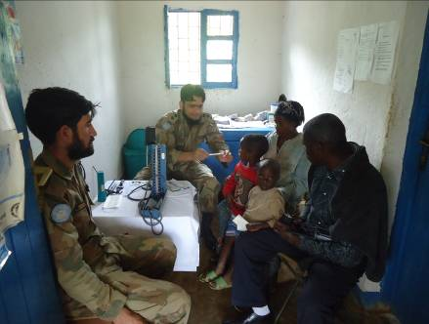
GENDER SPECIFIC QIP
MEDICAL CAMP IN PROGRESS AT VILLAGE CHULWE (REMOTE AREA) 10 JAN 2012
Notes:
46

Slide 47
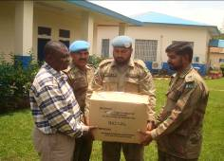
GENDER SPECIFIC QIP
ASSISTANCE TO MR JUSTIN – LOCAL INTERPRETER FOR THE MARRIAGE OF HIS DAUGHTER : MAR 2012
Notes:
47

Slide 48
CASE STUDIES

Slide 49




PRESENT STATUS
Notes:
49

Slide 50
REASONS FOR CONFLICT
NEGATIVE ARMED GROUPS - CONFLICT
MINERALS
ETHNIC POLARISATION
WEAK GOVERNMENT INSTITUTIONS
Notes:
50

Slide 51

MINERAL RESOURCES
LEGEND
GOLD
DIAMONDS
COLTAN
PALM OIL AND TIMBER
POSSIBLE OIL
GAS
LEGEND

Slide 52
NEGATIVE ARMED GROUPS
LEGEND
LRA
GOLD
DIAMONDS
COLTAN
PALM OIL AND TIMBER
POSSIBLE OIL
FRPI
FDLR,
ADF&
MM
GAS
MM
LEGEND

Slide 53

ETHNIC POLARISATION
OVER 250 ETHNIC GROUPS
  STRONG ETHNIC GROUP AFFILIFATIONS
  INTER GROUP RIVALRY
OVER 200 ETHNIC LANGUAGES
Notes:
53

Slide 54
WEAK GOVERNMENT INSTITUTIONS
EVOLVING DEMOCRACY
INDEPENDENT NATIONAL ELECTION COMMISSION (CENI)
  CONDUCTED FIRST PRESIDENTIAL AND LEGISLATIVE
  ASSEMBLY ELECTIONS IN NOV 2011
  MAJOR OBSERVATIONS – CARTER CENTRE, CHURCH,
  MONUSCO etc.
CONGOLESE NATIONAL POLICE (PNC)
  STRENTH - 1,08,000
  LACK OF EQUIPMENT
  LACK OF TRAINING
  POOR EMOLUMENTS – LACK OF MOTIVATION
ARMED FORCES OF DRC (FARDC)
  STRENTH – 1,60,000
  INTEGRATED ARMED GROUPS – OLD ALLIANCES
  LACK OF EQUIPMENT
  LACK OF TRAINING
  EMOLUMENTS – LACK OF MOTIVATION
JUDICIAL SYSTEM
Notes:
54

